Slide 1

WSQ Course Code: TGS-2024043856
Enhance Work Productivity with Microsoft 365 Copilot
Version v9.4 · 20 October 2026
Tertiary Infotech Academy Pte Ltd
UEN: 201200696W
www.tertiarycourses.com.sg | enquiry@tertiaryinfotech.com | +65 6100 0613
© Tertiary Infotech Academy Pte Ltd
Enhance Work Productivity with Microsoft 365 Copilot · TGS-2024043856
1

Slide 2
TRAQOM · SSG
Digital Attendance (Mandatory)
TRAQOM survey
Complete the SSG Training Quality and Outcome Measurement survey when instructed.
Assessment
Complete the separate assessment attendance before the papers.
1
2
Scan
Use the QR code shown by the trainer or administrator.
Eligibility
Maintain at least 75% attendance and achieve a Competent outcome.
3
4
© Tertiary Infotech Academy Pte Ltd
Enhance Work Productivity with Microsoft 365 Copilot · TGS-2024043856
2

Slide 3
COURSE ADMINISTRATION
Welcome & Housekeeping
© Tertiary Infotech Academy Pte Ltd
Enhance Work Productivity with Microsoft 365 Copilot · TGS-2024043856
3

Slide 4
GENERAL TRAINER TEMPLATE
About the Trainer
NAME
____________________________________________
?
TITLE / DESIGNATION
____________________________________________
QUALIFICATIONS
____________________________________________
Your Trainer
EXPERTISE
____________________________________________
Complete before class
EXPERIENCE
____________________________________________
CONTACT
____________________________________________
© Tertiary Infotech Academy Pte Ltd
Enhance Work Productivity with Microsoft 365 Copilot · TGS-2024043856
4

Slide 5
NAMED TRAINER
About the Trainer
ROLE
Principal Trainer and Chief Instructional Designer
AA
EXPERTISE
Microsoft 365, AI, automation and business productivity
CERTIFICATION
ACLP-certified adult educator
Dr Alfred Ang
DELIVERS
WSQ and professional technology programmes
Principal Trainer · Tertiary Infotech Academy
EXPERIENCE
Cross-industry transformation and workforce training
CONTACT
enquiry@tertiaryinfotech.com
© Tertiary Infotech Academy Pte Ltd
Enhance Work Productivity with Microsoft 365 Copilot · TGS-2024043856
5

Slide 6
ICE-BREAKER
Let's Know Each Other
Your name, role and one HR service reporting task.
Which app holds the HR-case source?
1
2
Which date and status definitions determine overdue work?
Check which Copilot buttons and skills menus are available in your assigned apps.
3
4
© Tertiary Infotech Academy Pte Ltd
Enhance Work Productivity with Microsoft 365 Copilot · TGS-2024043856
6

Slide 7
HOUSEKEEPING
Ground Rules
Set your mobile phone to silent mode.
Participate actively — no question is too small.
1
2
Mutual respect: agree to disagree.
One conversation at a time.
3
4
Be punctual; return from breaks on time.
Learn by doing — try every hands-on lab.
5
6
© Tertiary Infotech Academy Pte Ltd
Enhance Work Productivity with Microsoft 365 Copilot · TGS-2024043856
7

Slide 8
COURSE MATERIALS
Your Course Materials
1
2
3
4
5
▶
▶
▶
▶
Trainer slides explain concepts and evidence boundaries
Learner Guide contains detailed procedures and troubleshooting
14 lab folders provide prompts, synthetic data and checkpoints
Prompt page supports clean copy and paste by app
Keep outputs in one dated Lumina working folder
Course page: https://www.tertiarycourses.com.sg/wsq-enhance-work-productivity-with-microsoft-365-copilot.html
© Tertiary Infotech Academy Pte Ltd
Enhance Work Productivity with Microsoft 365 Copilot · TGS-2024043856
8

Slide 9
SCHEDULE
Lesson Plan — 2 Days, 14 instructional hours
Course sequence
Day 2
• Day 1 — Copilot fundamentals, reusable Skills and controlled transition
– Topic 1: Overview of Microsoft Copilot (Labs 1–2)
– Topic 2: Microsoft Copilot for Excel (Labs 3–6)
• Day 2 — Interactive dashboard, professional presentation and Microsoft 365 business agents
– Topic 3: Create Interactive Dashboard with Microsoft Copilot (Labs 7–10)
– Topic 4: Create Microsoft Agent (Labs 11–14)
• Daily timing
– 9:00 am - 6:30 pm (1-hour lunch; two 15-minute breaks excluded; 7 instructional hours plus 1 assessment hour)
© Tertiary Infotech Academy Pte Ltd
Enhance Work Productivity with Microsoft 365 Copilot · TGS-2024043856
9

Slide 10
WHAT YOU'LL ACHIEVE
Learning Outcomes
Integration risks
Predict and mitigate challenges in integrating Microsoft Copilot to workflow.
Transition plan
Develop a plan for implementing Microsoft Copilot to ensure seamless transition from legacy workflow.
1
2
Copilot opportunities
Evaluate opportunities in using Microsoft Copilot.
Staff training plan
Design a training plan for staff to use Microsoft Copilot.
3
4
© Tertiary Infotech Academy Pte Ltd
Enhance Work Productivity with Microsoft 365 Copilot · TGS-2024043856
10

Slide 11
WSQ LEARNING APPROACH
Learning and Assessment Route
1
2
3
4
5
▶
▶
▶
▶
Trainer demonstrates the technical mechanism
You build and verify it in a connected lab
WA-SAQ: 60 minutes · K1-K4
PP: 60 minutes · A1-A4
Competent outcome + minimum 75% attendance
© Tertiary Infotech Academy Pte Ltd
Enhance Work Productivity with Microsoft 365 Copilot · TGS-2024043856
11

Slide 12
DIGITAL TECHNOLOGY ADOPTION AND INNOVATION · ACC-ICT-4004-1.1
Skills Framework Alignment
K1
Relevant systems and software
K2
Organisation's processes
1
2
K3
Systems transition process
K4
Emerging technological trends such as machine learning, artificial intelligence and robotic process automation
3
4
A1–A4
Transition risks, controlled implementation, opportunity evaluation and staff enablement are practised across 14 labs.
5
© Tertiary Infotech Academy Pte Ltd
Enhance Work Productivity with Microsoft 365 Copilot · TGS-2024043856
12

Slide 13
TOPIC 1
Overview of Microsoft Copilot
Grounding, HR-case grain, prompts and verified handoffs
© Tertiary Infotech Academy Pte Ltd
Enhance Work Productivity with Microsoft 365 Copilot · TGS-2024043856
13

Slide 14
KEY CONCEPTS · K1 · A1
Key Concepts — Overview of Microsoft Copilot
Grounding
Select actual sources in every app.
HR cases
Keep IDs, dates, status and current ownership stable.
1
2
Prompt contract
Goal, context, source and expected output.
Transition risk
Verify licences, permissions, data quality and claims.
3
4
© Tertiary Infotech Academy Pte Ltd
Enhance Work Productivity with Microsoft 365 Copilot · TGS-2024043856
14

Slide 15
WHAT YOU'LL DO
Hands-On Labs — Overview of Microsoft Copilot
Lab 1
Lab 2
• Excel to Word
– Prepare HR Cases and Draft the HR Service Brief
• Word to PowerPoint and Outlook
– Create the Cross-App HR Service Update
© Tertiary Infotech Academy Pte Ltd
Enhance Work Productivity with Microsoft 365 Copilot · TGS-2024043856
15

Slide 16
CONNECTED USE CASE
The Lumina HR Service Evidence Chain
1
2
3
4
▶
▶
▶
Excel: clean and check
Word: HR service brief
PowerPoint: decision story
Outlook: reviewed draft
© Tertiary Infotech Academy Pte Ltd
Enhance Work Productivity with Microsoft 365 Copilot · TGS-2024043856
16

Slide 17
EDITABLE DATA MODEL
A HR Case Has State, Scope and Ownership
ID
Department
Category
HR-2026-0003
Retail Sales
Leave Request
Status
Owner
In Progress
Chloe Goh
Current owner is evidence. Proposed owner is a separate planning output.
Source: synthetic tblHRCases | 30 Sep 2026 | All filters All unless stated
© Tertiary Infotech Academy Pte Ltd
Enhance Work Productivity with Microsoft 365 Copilot · TGS-2024043856
17

Slide 18
LAB 1 · CONCEPT
Grounding Across Microsoft 365
WHAT IT IS
WHY IT MATTERS
CHECK IT
• Grounding gives an AI request the specific evidence it should use.
• An HR service figure can be correct in Excel yet become wrong in an email when the source, reporting date or filter scope changes.
• Excel analyses tblHRCases; Word receives the checked summary.
© Tertiary Infotech Academy Pte Ltd
Enhance Work Productivity with Microsoft 365 Copilot · TGS-2024043856
18

Slide 19
LAB 1 · HOW IT WORKS
Grounding Across Microsoft 365
1
2
3
4
▶
▶
▶
Identify the authoritative HR-case table.
Provide goal, context, source and expected output.
Review against the named evidence.
Pass a verified snapshot to the next app.
© Tertiary Infotech Academy Pte Ltd
Enhance Work Productivity with Microsoft 365 Copilot · TGS-2024043856
19

Slide 20
LAB 1 · HOW TO USE IT
Apply the Concept — Grounding Across Microsoft 365
PROMPT PRINCIPLES
EVIDENCE TO CHECK
• Name the source, reporting date and selected scope.
• Explain the result using checked evidence.
• PowerPoint receives the reviewed Word brief; Outlook receives the same checked values.
• An Excel chat transcript is not an automatic PowerPoint data source.
© Tertiary Infotech Academy Pte Ltd
Enhance Work Productivity with Microsoft 365 Copilot · TGS-2024043856
20

Slide 21
LAB 1 · TECHNICAL ANCHOR
Evidence Trace — Grounding Across Microsoft 365
Source
https://support.microsoft.com/en-us/microsoft-365-copilot/file-formats-supported-by-microsoft-365-copilot
State
Excel analyses tblHRCases; Word receives the checked summary.
1
2
Check
PowerPoint receives the reviewed Word brief; Outlook receives the same checked values.
Boundary
The prompt assumes access to another app chat or local path.
3
4
© Tertiary Infotech Academy Pte Ltd
Enhance Work Productivity with Microsoft 365 Copilot · TGS-2024043856
21

Slide 22
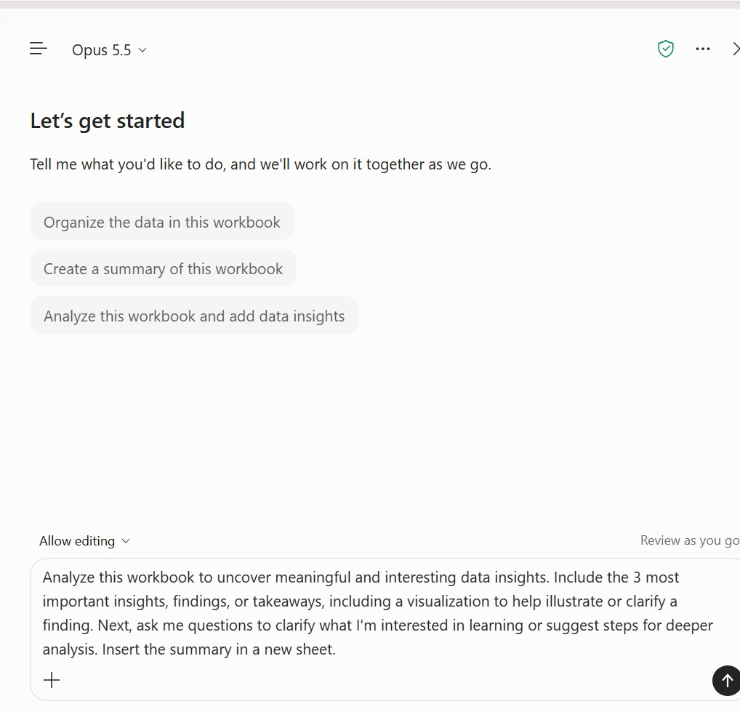
LAB 1 · SCREENSHOT
Copilot in Excel — The Chat Pane
Open the pane
Select Copilot on the Home ribbon or the Copilot button at the bottom-right of the grid.
1
Model picker
Shows the model in use. Auto picks one per task; keep the approved default.
2
Starter prompts
Replace generic starters with a grounded request: goal, source, 30 Sep 2026 and scope.
3
Mode and review
Allow editing changes the workbook; Review as you go lets you keep or undo each change.
4
Prompt box and +
Paste the lab prompt; use + to attach the exact Lumina source before sending.
5
© Tertiary Infotech Academy Pte Ltd
Enhance Work Productivity with Microsoft 365 Copilot · TGS-2024043856
22

Slide 23
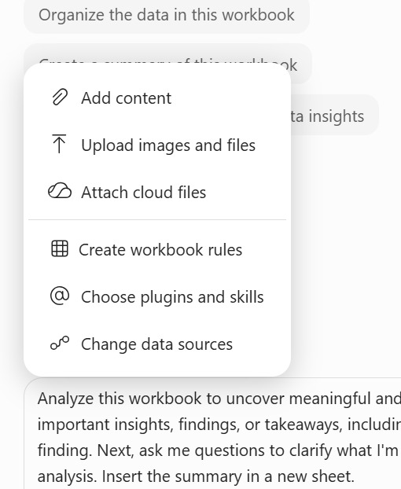
LAB 1 · SCREENSHOT
Ground the Request with the + Menu
Attach cloud files
Point Copilot at the approved OneDrive copy of Lumina_HR_Cases.xlsx.
1
Upload images and files
Add a local file, such as a supplied HR template, when the lab asks for it.
2
Create workbook rules
Starts a visible .Rules sheet of workbook conventions (Lab 4).
3
Choose plugins and skills
Invoke a built-in or custom Skill such as hr-case-pareto (Labs 5–7).
4
Change data sources
Confirm which data Copilot reads before you trust any figure.
5
© Tertiary Infotech Academy Pte Ltd
Enhance Work Productivity with Microsoft 365 Copilot · TGS-2024043856
23

Slide 24
LAB 1 · CONCEPT
HR-Case Grain and Reporting Measures
WHAT IT IS
WHY IT MATTERS
CHECK IT
• A row represents one HR case, identified by Case_ID.
• An exact duplicated export row changes counts and cost without representing new work.
• 122 raw rows contain 120 distinct HR-case IDs.
© Tertiary Infotech Academy Pte Ltd
Enhance Work Productivity with Microsoft 365 Copilot · TGS-2024043856
24

Slide 25
LAB 1 · HOW IT WORKS
HR-Case Grain and Reporting Measures
1
2
3
4
▶
▶
▶
Define one ID per HR case.
Find exact repeated export records.
Standardise labels without inventing facts.
Reconcile cleaned counts and cost.
© Tertiary Infotech Academy Pte Ltd
Enhance Work Productivity with Microsoft 365 Copilot · TGS-2024043856
25

Slide 26
LAB 1 · HOW TO USE IT
Apply the Concept — HR-Case Grain and Reporting Measures
PROMPT PRINCIPLES
EVIDENCE TO CHECK
• Name the source, reporting date and selected scope.
• Explain the result using checked evidence.
• Total = Closed + Cancelled + Backlog after exact duplicate removal.
• Due on 30 September is not overdue at the 30 September snapshot.
© Tertiary Infotech Academy Pte Ltd
Enhance Work Productivity with Microsoft 365 Copilot · TGS-2024043856
26

Slide 27
LAB 1 · TECHNICAL ANCHOR
Evidence Trace — HR-Case Grain and Reporting Measures
Source
https://support.microsoft.com/en-us/excel/create-and-share-a-dashboard-with-excel-and-microsoft-groups
State
122 raw rows contain 120 distinct HR-case IDs.
1
2
Check
Total = Closed + Cancelled + Backlog after exact duplicate removal.
Boundary
Duplicate IDs contain conflicting records or reporting scope is unknown.
3
4
© Tertiary Infotech Academy Pte Ltd
Enhance Work Productivity with Microsoft 365 Copilot · TGS-2024043856
27

Slide 28
LAB 1 THEME · EXCEL TO WORD
Prepare HR Cases and Draft the HR Service Brief
LAB 1
You are Lumina Living’s HR operations executive. A Q3 export contains repeated IDs and inconsistent category labels.
You'll build
Lumina_Clean_HR_Cases.xlsx and Lumina_HR_Service_Brief.docx, with reconciled counts, reporting scope and a source register.
1 Ground
2 Build
3 Verify
4 Handoff
Tools: Microsoft 365 Copilot · Excel · Word · PowerPoint · Outlook · OneDrive
© Tertiary Infotech Academy Pte Ltd
Enhance Work Productivity with Microsoft 365 Copilot · TGS-2024043856
28

Slide 29
LAB 1 · PROMPTS TO TRY
Sample Prompts — Lab 1
Inspect: Using Lumina_HR_Cases.xlsx, confirm 120 unique Case_ID values, preserve Current_Assignee, and report data-quality exceptions at 30 September 2026.
1
Brief: Draft the Lumina HR Service Brief from the verified 120-row snapshot; cite backlog 60 and overdue 50 and label missing causes UNKNOWN.
2
© Tertiary Infotech Academy Pte Ltd
Enhance Work Productivity with Microsoft 365 Copilot · TGS-2024043856
29

Slide 30
LAB 1 · VERIFY
Check Your Results — Lab 1
Clean table
120 unique Case_ID rows; five canonical request types.
Portfolio identity
120 = 48 Closed + 12 Cancelled + 60 backlog.
1
2
Evidence handoff
Overdue 50; unassigned backlog 6; total cost S$35,827.50. Word agrees with Excel.
No guessed owner
Blank assignments remain blank; proposals labelled unapproved.
3
4
© Tertiary Infotech Academy Pte Ltd
Enhance Work Productivity with Microsoft 365 Copilot · TGS-2024043856
30

Slide 31
LAB 2 · CONCEPT
Prompts and Verified App Handoffs
WHAT IT IS
WHY IT MATTERS
CHECK IT
• A useful prompt combines the intended goal, operational context, named source and output expectations.
• The same number may have different meaning when a chart counts all HR cases while an email calls it open backlog.
• Goal: draft an HR service update for the HR manager.
© Tertiary Infotech Academy Pte Ltd
Enhance Work Productivity with Microsoft 365 Copilot · TGS-2024043856
31

Slide 32
LAB 2 · HOW IT WORKS
Prompts and Verified App Handoffs
1
2
3
4
▶
▶
▶
Write the goal and audience.
Attach or select the actual source.
Specify definitions and missing-value behaviour.
Reconcile the returned claims.
© Tertiary Infotech Academy Pte Ltd
Enhance Work Productivity with Microsoft 365 Copilot · TGS-2024043856
32

Slide 33
LAB 2 · HOW TO USE IT
Apply the Concept — Prompts and Verified App Handoffs
PROMPT PRINCIPLES
EVIDENCE TO CHECK
• Name the source, reporting date and selected scope.
• Explain the result using checked evidence.
• Source: reviewed Lumina HR service brief, all filters All, 30 September.
• Expectation: label assignment suggestions as proposals and leave unknown approvals UNKNOWN.
© Tertiary Infotech Academy Pte Ltd
Enhance Work Productivity with Microsoft 365 Copilot · TGS-2024043856
33

Slide 34
LAB 2 · TECHNICAL ANCHOR
Evidence Trace — Prompts and Verified App Handoffs
Source
https://support.microsoft.com/en-gb/word/copilot/draft-and-add-content-with-copilot-in-word
State
Goal: draft an HR service update for the HR manager.
1
2
Check
Source: reviewed Lumina HR service brief, all filters All, 30 September.
Boundary
Only an unverified summary is available.
3
4
© Tertiary Infotech Academy Pte Ltd
Enhance Work Productivity with Microsoft 365 Copilot · TGS-2024043856
34

Slide 35
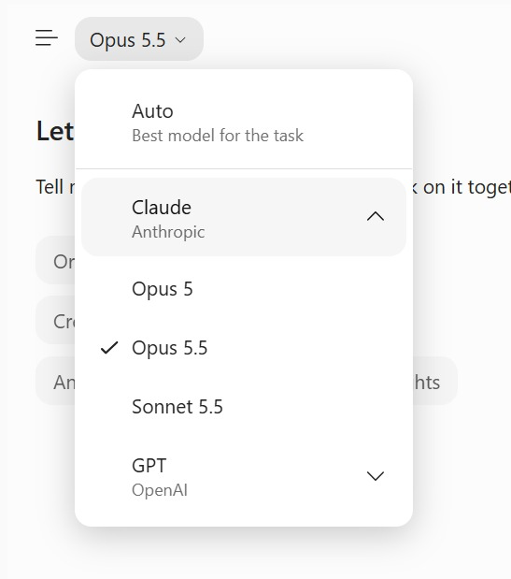
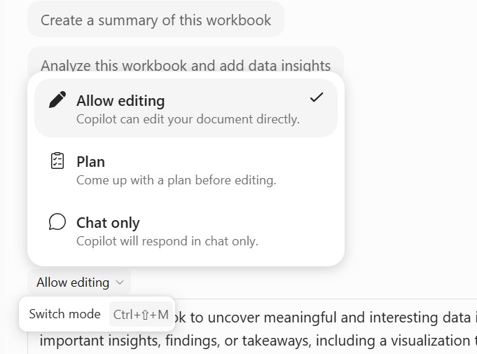
LAB 2 · SCREENSHOT
Choose the Model, Then the Mode
Model picker
Auto chooses per task. Use the approved default and retest after any change (AI Security principle 5).
Allow editing · Plan · Chat only
Edit changes the file, Plan proposes steps first, Chat only never edits. Switch with Ctrl+Shift+M.
© Tertiary Infotech Academy Pte Ltd
Enhance Work Productivity with Microsoft 365 Copilot · TGS-2024043856
35

Slide 36
LAB 2 · CONCEPT
Outlook Drafting and Operational Decisions
WHAT IT IS
WHY IT MATTERS
CHECK IT
• Copilot can help structure a draft email from supplied context.
• An apparently routine update can accidentally promise HR officer reassignment or imply that a manager approved a recovery plan.
• Current owner blank; proposed owner Aisha remains unapproved.
© Tertiary Infotech Academy Pte Ltd
Enhance Work Productivity with Microsoft 365 Copilot · TGS-2024043856
36

Slide 37
LAB 2 · HOW IT WORKS
Outlook Drafting and Operational Decisions
1
2
3
4
▶
▶
▶
Provide the synthetic thread and checked facts.
Draft a concise update.
Review recipients, facts and action wording.
Save the unsent draft and evidence.
© Tertiary Infotech Academy Pte Ltd
Enhance Work Productivity with Microsoft 365 Copilot · TGS-2024043856
37

Slide 38
LAB 2 · HOW TO USE IT
Apply the Concept — Outlook Drafting and Operational Decisions
PROMPT PRINCIPLES
EVIDENCE TO CHECK
• Name the source, reporting date and selected scope.
• Explain the result using checked evidence.
• A draft addressed to example.invalid is a training artifact.
• The handoff says decision requested, not decision approved.
© Tertiary Infotech Academy Pte Ltd
Enhance Work Productivity with Microsoft 365 Copilot · TGS-2024043856
38

Slide 39
LAB 2 · TECHNICAL ANCHOR
Evidence Trace — Outlook Drafting and Operational Decisions
Source
https://support.microsoft.com/en-us/microsoft-365-copilot/file-formats-supported-by-microsoft-365-copilot
State
Current owner blank; proposed owner Aisha remains unapproved.
1
2
Check
A draft addressed to example.invalid is a training artifact.
Boundary
The task would imply a real approval or send without review.
3
4
© Tertiary Infotech Academy Pte Ltd
Enhance Work Productivity with Microsoft 365 Copilot · TGS-2024043856
39

Slide 40
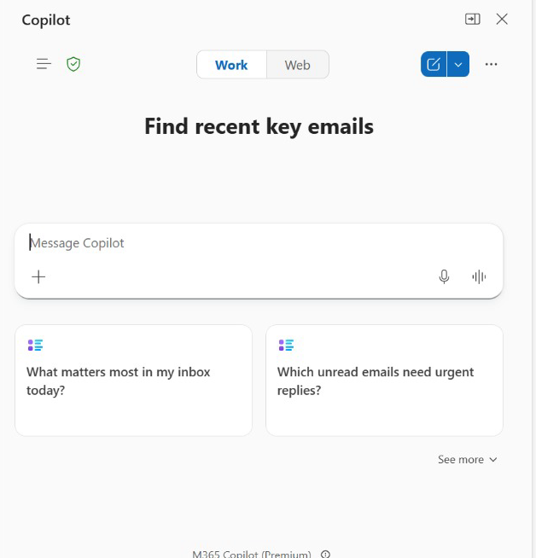
LAB 2 · SCREENSHOT
Copilot in Outlook — Work or Web
Work / Web
Work grounds answers in your mail and files; Web uses public content. Keep HR drafting on Work.
1
Message Copilot
Ask for the update email and name the reviewed brief; + attaches it.
2
Suggested prompts
Inbox-triage starters help orientation but are never evidence for HR figures.
3
Human control
Check every figure against the brief and leave the email unsent until approved.
4
© Tertiary Infotech Academy Pte Ltd
Enhance Work Productivity with Microsoft 365 Copilot · TGS-2024043856
40

Slide 41
LAB 2 THEME · WORD TO POWERPOINT AND OUTLOOK
Create the Cross-App HR Service Update
LAB 2
Continue the verified HR service brief from Lab 1. You will turn it into an initial PowerPoint update, then prepare an Outlook reply to a synthetic HR service thread.
You'll build
Lumina_Initial_Update.pptx, an unsent Outlook draft and Lumina_Cross_App_Evidence.csv with Excel, Word, PowerPoint and Outlook figures reconciled.
1 Ground
2 Build
3 Verify
4 Handoff
Tools: Microsoft 365 Copilot · Excel · Word · PowerPoint · Outlook · OneDrive
© Tertiary Infotech Academy Pte Ltd
Enhance Work Productivity with Microsoft 365 Copilot · TGS-2024043856
41

Slide 42
LAB 2 · PROMPTS TO TRY
Sample Prompts — Lab 2
Handoff: Using the verified Lumina HR Service Brief, create a five-slide HR service update and an unsent Outlook draft with the same 30 September 2026 scope.
1
Verify: Reconcile every count, date and current assignment in the deck and email against Lumina_HR_Cases.xlsx.
2
© Tertiary Infotech Academy Pte Ltd
Enhance Work Productivity with Microsoft 365 Copilot · TGS-2024043856
42

Slide 43
LAB 2 · VERIFY
Check Your Results — Lab 2
Four apps
Excel Checks, Word brief, four-slide update and unsent Outlook draft share the same date and values.
Cross-app grounding
Named file or pasted verified evidence is provided in each app; no assumed shared chat.
1
2
Draft boundary
example.invalid recipient; nothing sent and no assignment approved.
LO1 checkpoint
Integration Risk Register has all three rows, fixed date/baseline evidence and no invented cause or approval.
3
4
© Tertiary Infotech Academy Pte Ltd
Enhance Work Productivity with Microsoft 365 Copilot · TGS-2024043856
43

Slide 44
TOPIC RECAP
Recap - Overview of Microsoft Copilot
LO1: Integration risks and verified cross-app handoffs documented.
1
Verify: 120 unique IDs; facts and proposals separate.
2
© Tertiary Infotech Academy Pte Ltd
Enhance Work Productivity with Microsoft 365 Copilot · TGS-2024043856
44

Slide 45
TOPIC 2
Microsoft Copilot for Excel
Account preferences, workbook conventions and reusable methods
© Tertiary Infotech Academy Pte Ltd
Enhance Work Productivity with Microsoft 365 Copilot · TGS-2024043856
45

Slide 46
KEY CONCEPTS · K3 · A2
Key Concepts — Microsoft Copilot for Excel
Personalisation
Account preferences across workbooks.
.Rules
Visible instructions travel with the workbook.
1
2
Skills
Reusable Pareto, reporting and dashboard methods.
Transition plan
Protect source, test reruns and preserve rollback.
3
4
© Tertiary Infotech Academy Pte Ltd
Enhance Work Productivity with Microsoft 365 Copilot · TGS-2024043856
46

Slide 47
WHAT YOU'LL DO
Hands-On Labs — Microsoft Copilot for Excel
Labs 3–4
Labs 5–6
• Personalisation
– Personalise Copilot in Excel for Consistent HR Service Reports
• Workbook .Rules
– Create and Test Workbook .Rules for HR Service Reporting
• Custom Pareto Chart Skill
– Create a Custom Pareto Chart Skill and Apply It
• Reporting Skill
– Create, Use and Improve the HR Service Reporting Skill
© Tertiary Infotech Academy Pte Ltd
Enhance Work Productivity with Microsoft 365 Copilot · TGS-2024043856
47

Slide 48
EDITABLE SCOPE COMPARISON
Four Scopes of Customisation
1
2
3
4
▶
▶
▶
Personalisation: your account
.Rules: this workbook
Skill: repeated method
Prompt: this request
© Tertiary Infotech Academy Pte Ltd
Enhance Work Productivity with Microsoft 365 Copilot · TGS-2024043856
48

Slide 49
LAB 3 · CONCEPT
Account Personalisation and Specific Requests
WHAT IT IS
WHY IT MATTERS
CHECK IT
• Excel Copilot Personalisation stores account-level preferences for display, writing style and formula conventions.
• Consistent S$ display and short explanations reduce repetitive requests without changing numeric values.
• A value of 35827.5 can display as S$35,827.50 or S$35,827.5000.
© Tertiary Infotech Academy Pte Ltd
Enhance Work Productivity with Microsoft 365 Copilot · TGS-2024043856
49

Slide 50
LAB 3 · HOW IT WORKS
Account Personalisation and Specific Requests
1
2
3
4
▶
▶
▶
Choose recurring display preferences.
Save them to the account.
Compare two workbook outputs.
Test a specific request and restore.
© Tertiary Infotech Academy Pte Ltd
Enhance Work Productivity with Microsoft 365 Copilot · TGS-2024043856
50

Slide 51
LAB 3 · HOW TO USE IT
Apply the Concept — Account Personalisation and Specific Requests
PROMPT PRINCIPLES
EVIDENCE TO CHECK
• Name the source, reporting date and selected scope.
• Explain the result using checked evidence.
• Changing a number format does not change its numeric value.
• Another user opening the file does not receive your account preferences.
© Tertiary Infotech Academy Pte Ltd
Enhance Work Productivity with Microsoft 365 Copilot · TGS-2024043856
51

Slide 52
LAB 3 · TECHNICAL ANCHOR
Evidence Trace — Account Personalisation and Specific Requests
Source
https://support.microsoft.com/en-us/excel/copilot/copilot-in-excel-personalization
State
A value of 35827.5 can display as S$35,827.50 or S$35,827.5000.
1
2
Check
Changing a number format does not change its numeric value.
Boundary
The instruction is a workbook-specific business rule or source change.
3
4
© Tertiary Infotech Academy Pte Ltd
Enhance Work Productivity with Microsoft 365 Copilot · TGS-2024043856
52

Slide 53
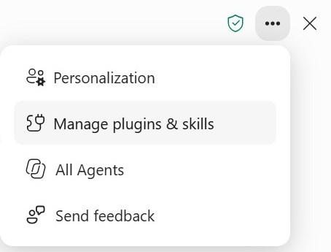
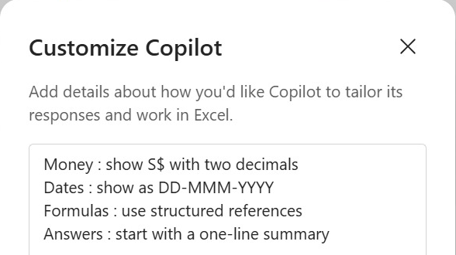
LAB 3 · SCREENSHOT
Personalisation — Where It Lives
Open ••• > Personalization
Personalization is the first item. The same menu opens Manage plugins & skills (Labs 5–7) and All Agents (Topic 4).
Customize Copilot
Enter the four Lab 3 lines (S$ two decimals, DD-MMM-YYYY, structured references, one-line summary), then Save.
© Tertiary Infotech Academy Pte Ltd
Enhance Work Productivity with Microsoft 365 Copilot · TGS-2024043856
53

Slide 54
LAB 3 THEME · PERSONALISATION
Personalise Copilot in Excel for Consistent HR Service Reports
LAB 3
Configure temporary account-level display and explanation preferences, test them in two copies of the same verified Lumina workbook, and distinguish preferences from workbook-specific definitions. A task-specific prompt can supersede Personalisation.
You'll build
Lumina_Personalisation_Test.xlsx, a two-workbook preference comparison and a private note confirming settings restored.
1 Ground
2 Build
3 Verify
4 Handoff
Tools: Microsoft 365 Copilot in Excel · OneDrive
© Tertiary Infotech Academy Pte Ltd
Enhance Work Productivity with Microsoft 365 Copilot · TGS-2024043856
54

Slide 55
LAB 3 · PROMPTS TO TRY
Sample Prompts — Lab 3
Personalise: For Lumina HR service reports, prefer concise headings, SGD currency, DD MMM YYYY dates and a Sources and Limitations section.
1
Test: Summarise Lumina backlog 60 and overdue 50 with and without the saved preference; record the observed difference.
2
© Tertiary Infotech Academy Pte Ltd
Enhance Work Productivity with Microsoft 365 Copilot · TGS-2024043856
55

Slide 56
LAB 3 · VERIFY
Check Your Results — Lab 3
Source controls
Both copies retain120 unique IDs, original owners/statuses and exact cost 35827.50.
Display check
Saved S$ two-decimal/date/explanation preferences are checked in two workbooks; observed misses are recorded.
1
2
Specific request
The output can show35,827.5000 without changing its value or the saved preferences.
Restoration
Previous account preferences restored; private baseline note stays outside public courseware.
3
4
© Tertiary Infotech Academy Pte Ltd
Enhance Work Productivity with Microsoft 365 Copilot · TGS-2024043856
56

Slide 57
EDITABLE WORKBOOK MODEL
Visible .Rules: Instructions Travel with the Workbook
A1
Lumina reporting conventions
A2
Preserve original IDs and current owners
A3
Backlog excludes Closed and Cancelled
A4
Reporting date: 2026-09-30
Formula rule reads Control!B2; Copilot uses the recalculated result on the next request.
Source: synthetic tblHRCases | 30 Sep 2026 | All filters All unless stated
© Tertiary Infotech Academy Pte Ltd
Enhance Work Productivity with Microsoft 365 Copilot · TGS-2024043856
57

Slide 58
LAB 4 · CONCEPT
Visible Workbook .Rules and Formula Results
WHAT IT IS
WHY IT MATTERS
CHECK IT
• A visible worksheet named exactly .Rules, including the dot, supplies workbook-specific Copilot instructions in column A.
• The workbook can carry stable scope, status, cost-display and preservation instructions alongside the source.
• The date rule returns Reporting date: 2026-09-30 from Control!B2.
© Tertiary Infotech Academy Pte Ltd
Enhance Work Productivity with Microsoft 365 Copilot · TGS-2024043856
58

Slide 59
LAB 4 · HOW IT WORKS
Visible Workbook .Rules and Formula Results
1
2
3
4
▶
▶
▶
Name the visible sheet exactly .Rules.
Place one instruction per column-A cell.
Recalculate a formula-driven rule.
Check the next output and copied workbook.
© Tertiary Infotech Academy Pte Ltd
Enhance Work Productivity with Microsoft 365 Copilot · TGS-2024043856
59

Slide 60
LAB 4 · HOW TO USE IT
Apply the Concept — Visible Workbook .Rules and Formula Results
PROMPT PRINCIPLES
EVIDENCE TO CHECK
• Name the source, reporting date and selected scope.
• Explain the result using checked evidence.
• Hidden .Rules is not used; keep the final sheet visible.
• No universal precedence among rules, preferences and Skills is assumed.
© Tertiary Infotech Academy Pte Ltd
Enhance Work Productivity with Microsoft 365 Copilot · TGS-2024043856
60

Slide 61
LAB 4 · TECHNICAL ANCHOR
Evidence Trace — Visible Workbook .Rules and Formula Results
Source
https://support.microsoft.com/en-us/excel/copilot/copilot-in-excel-rules
State
The date rule returns Reporting date: 2026-09-30 from Control!B2.
1
2
Check
Hidden .Rules is not used; keep the final sheet visible.
Boundary
You need a security boundary or are assuming hidden rules apply.
3
4
© Tertiary Infotech Academy Pte Ltd
Enhance Work Productivity with Microsoft 365 Copilot · TGS-2024043856
61

Slide 62
LAB 4 THEME · WORKBOOK .RULES
Create and Test Workbook .Rules for HR Service Reporting
LAB 4
Turn Lumina’s workbook conventions into a visible .Rules worksheet. Keep one rule per cell in column A, include a formula-driven reporting-date rule, test the output, and verify that the sheet travels with a copied workbook.
You'll build
Lumina_Rules_Workbook.xlsx with visible .Rules column A, a checked Rules_Test output and a copied-workbook sharing check.
1 Ground
2 Build
3 Verify
4 Handoff
Tools: Microsoft 365 Copilot in Excel · OneDrive
© Tertiary Infotech Academy Pte Ltd
Enhance Work Productivity with Microsoft 365 Copilot · TGS-2024043856
62

Slide 63
LAB 4 · PROMPTS TO TRY
Sample Prompts — Lab 4
.Rules: In the visible .Rules sheet, require 30 September 2026, UNKNOWN for missing evidence, and separate Current_Assignee from Proposed_Assignee.
1
Boundary: Test one request that lacks a reporting date and verify that Copilot asks for it instead of guessing.
2
© Tertiary Infotech Academy Pte Ltd
Enhance Work Productivity with Microsoft 365 Copilot · TGS-2024043856
63

Slide 64
LAB 4 · VERIFY
Check Your Results — Lab 4
Recognition
Exactly .Rules; visible worksheet; instructions in column A, one idea per cell.
Formula rule
Reporting-date formula recalculates and displays2026-09-30; no source values changed.
1
2
Output controls
120 total;60 backlog;50 overdue;30/48 on-time;S$35,827.50 at All scope.
Workbook copy
Visible .Rules travels with the copy; account preferences are not exported.
3
4
© Tertiary Infotech Academy Pte Ltd
Enhance Work Productivity with Microsoft 365 Copilot · TGS-2024043856
64

Slide 65
NATIVE EDITABLE PARETO EVIDENCE
Overdue Contribution: 50 HR Cases, Five Categories
Four categories first reach 80%. Equal counts use alphabetical ties. Contribution is not cause.
Source: synthetic tblHRCases | 30 Sep 2026 | All filters All unless stated
© Tertiary Infotech Academy Pte Ltd
Enhance Work Productivity with Microsoft 365 Copilot · TGS-2024043856
65

Slide 66
LAB 5 · CONCEPT
Pareto Skill: Counts, Sorting and Cumulative Share
WHAT IT IS
WHY IT MATTERS
CHECK IT
• A Pareto contribution chart cases category counts from largest to smallest and adds a cumulative-percentage line.
• The Skill turns a recurring grouping-and-charting method into reusable instructions.
• Payroll 18; Benefits 12; Leave 8; Training 8; Onboarding 4: total 50.
© Tertiary Infotech Academy Pte Ltd
Enhance Work Productivity with Microsoft 365 Copilot · TGS-2024043856
66

Slide 67
LAB 5 · HOW IT WORKS
Pareto Skill: Counts, Sorting and Cumulative Share
1
2
3
4
▶
▶
▶
Define source, population, date and grouping.
Count and sort with stable ties.
Calculate cumulative count / eligible total.
Build and verify an editable dual-axis chart.
© Tertiary Infotech Academy Pte Ltd
Enhance Work Productivity with Microsoft 365 Copilot · TGS-2024043856
67

Slide 68
LAB 5 · HOW TO USE IT
Apply the Concept — Pareto Skill: Counts, Sorting and Cumulative Share
PROMPT PRINCIPLES
EVIDENCE TO CHECK
• Name the source, reporting date and selected scope.
• Explain the result using checked evidence.
• Cumulative percentages are 36%, 60%, 76%, 92%, 100%.
• Four of five categories first reach 80%; do not force an 80/20 conclusion.
© Tertiary Infotech Academy Pte Ltd
Enhance Work Productivity with Microsoft 365 Copilot · TGS-2024043856
68

Slide 69
LAB 5 · TECHNICAL ANCHOR
Evidence Trace — Pareto Skill: Counts, Sorting and Cumulative Share
Source
https://support.microsoft.com/en-us/excel/copilot/copilot-in-excel-skills
State
Payroll 18; Benefits 12; Leave 8; Training 8; Onboarding 4: total 50.
1
2
Check
Cumulative percentages are 36%, 60%, 76%, 92%, 100%.
Boundary
Categories are being called causes or zero-total shares treated as measured 0%.
3
4
© Tertiary Infotech Academy Pte Ltd
Enhance Work Productivity with Microsoft 365 Copilot · TGS-2024043856
69

Slide 70
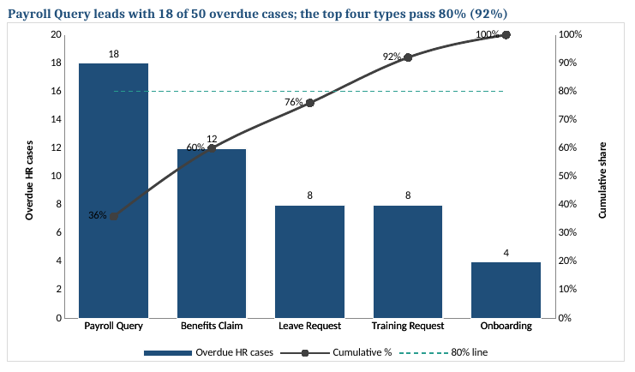
LAB 5 · SCREENSHOT
What Is a Pareto Chart?
1
Bars, largest first
Overdue HR cases per request type, sorted high to low: Payroll Query leads with 18 of 50.
2
Cumulative % line
Running share of the total on the right axis: 36%, 60%, 76%, 92%, 100%.
3
80% reference
Where the line passes the dashed 80% line marks the vital few types to tackle first.
4
Finding title
The title states the result from formulas, so it updates when the data or date changes.
5
Contribution, not cause
A Pareto shows where cases concentrate; it does not explain why.
© Tertiary Infotech Academy Pte Ltd
Enhance Work Productivity with Microsoft 365 Copilot · TGS-2024043856
70

Slide 71
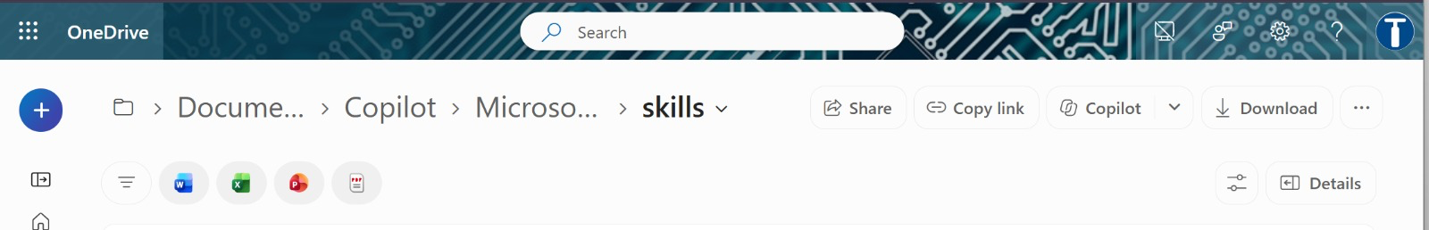
LAB 5 · SCREENSHOT
Where Custom Skills Live — The OneDrive skills Folder
1
Create the folder
2
Copy the Skill folder
3
Keep names exact
••• > Manage plugins & skills > Custom skills > Create OneDrive folder if needed > Open skills folder.
Copy the reviewed hr-case-pareto folder, with its SKILL.md, into this app-created skills location.
The folder name and the name inside SKILL.md must both read hr-case-pareto.
© Tertiary Infotech Academy Pte Ltd
Enhance Work Productivity with Microsoft 365 Copilot · TGS-2024043856
71

Slide 72
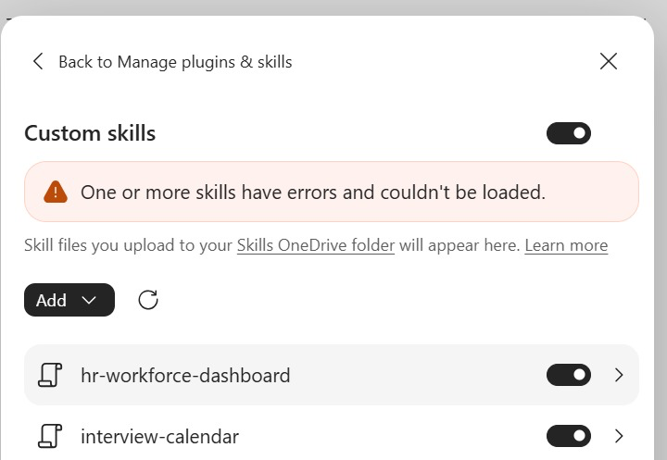
LAB 5 · SCREENSHOT
Custom Skills — Refresh, Enable, Verify
Skills OneDrive folder
This link opens the same folder; Skills copied there appear in the list.
1
Add and Refresh
Add uploads a Skill; Refresh re-reads the folder after you copy or edit SKILL.md.
2
Toggle on
Only enabled Skills can run. Enable hr-case-pareto; leave unrelated Skills off.
3
Error banner
"Couldn't be loaded" means a SKILL.md problem: check name and front matter, fix, Refresh.
4
© Tertiary Infotech Academy Pte Ltd
Enhance Work Productivity with Microsoft 365 Copilot · TGS-2024043856
72

Slide 73
LAB 5 THEME · CUSTOM PARETO CHART SKILL
Create a Custom Pareto Chart Skill and Apply It
LAB 5
Author hr-case-pareto/SKILL.md with Copilot, install it in Excel and apply it to the same overdue HR-case queue. Build a descending count chart plus cumulative-percentage line, then check a controlled rerun and a second grouping.
You'll build
hr-case-pareto/SKILL.md, Lumina_Pareto.xlsx with Pareto_Request_Type and Pareto_Department, and a verified rerun record.
1 Ground
2 Build
3 Verify
4 Handoff
Tools: Excel Copilot · Microsoft 365 Copilot web · OneDrive
© Tertiary Infotech Academy Pte Ltd
Enhance Work Productivity with Microsoft 365 Copilot · TGS-2024043856
73

Slide 74
LAB 5 · PROMPTS TO TRY
Sample Prompts — Lab 5
Run Skill: Apply @hr-case-pareto to Lumina_HR_Cases.xlsx for overdue work at 30 September 2026; verify category counts 18, 12, 8, 8, 4 and cumulative 100%.
1
Zero case: Run the zero-overdue test and return N/A rather than dividing by zero.
2
© Tertiary Infotech Academy Pte Ltd
Enhance Work Productivity with Microsoft 365 Copilot · TGS-2024043856
74

Slide 75
LAB 5 · VERIFY
Check Your Results — Lab 5
Eligible population
Overdue backlog50; no Closed or Cancelled records included.
Category counts
Payroll Query=18; Benefits Claim=12; Leave Request=8; Training Request=8; Onboarding=4
1
2
Cumulative percentages
36%,60%,76%,92%,100%; Leave Request precedes Training Request in the8-count tie.
Chart and rerun
Editable columns plus cumulative line; right axis0%-100%; matching output replaced only after review, without duplicates.
3
4
Source and interpretation
120 original records preserved; Department grouping also totals50; no invented root cause.
5
© Tertiary Infotech Academy Pte Ltd
Enhance Work Productivity with Microsoft 365 Copilot · TGS-2024043856
75

Slide 76
EDITABLE SKILL CONTRACT
Anatomy of the HR Service Skill
Discovery
name + description
When should Copilot use it?
Input guard
table or snapshot + date + scope
What evidence is missing?
Method
definitions + source preservation
How should measures be calculated?
Outputs
summary / charts / proposals
Which named areas may change?
Verification
counts + denominators + reruns
What proves the result?
Source: synthetic tblHRCases | 30 Sep 2026 | All filters All unless stated
© Tertiary Infotech Academy Pte Ltd
Enhance Work Productivity with Microsoft 365 Copilot · TGS-2024043856
76

Slide 77
REPEATABLE IMPROVEMENT
A Skill Improves Through Evidence
1
2
3
4
▶
▶
▶
v1 instructions
Run on verified inputs
Find one concrete defect
v2 + repeat the check
© Tertiary Infotech Academy Pte Ltd
Enhance Work Productivity with Microsoft 365 Copilot · TGS-2024043856
77

Slide 78
LAB 6 · CONCEPT
Skills, Prompts and Workbook Rules
WHAT IT IS
WHY IT MATTERS
CHECK IT
• A prompt is one request.
• The skill makes stable definitions and review boundaries reusable: backlog excludes two terminal statuses, overdue uses a fixed date, missing owners stay missing and output reruns do not duplicate sheets.
• hr-case-reporting contains definitions and output boundaries.
© Tertiary Infotech Academy Pte Ltd
Enhance Work Productivity with Microsoft 365 Copilot · TGS-2024043856
78

Slide 79
LAB 6 · HOW IT WORKS
Skills, Prompts and Workbook Rules
1
2
3
4
▶
▶
▶
Identify a recurring task.
Separate stable rules from current inputs.
Write name, description and instructions.
Install, invoke and inspect the result.
© Tertiary Infotech Academy Pte Ltd
Enhance Work Productivity with Microsoft 365 Copilot · TGS-2024043856
79

Slide 80
LAB 6 · HOW TO USE IT
Apply the Concept — Skills, Prompts and Workbook Rules
PROMPT PRINCIPLES
EVIDENCE TO CHECK
• Name the source, reporting date and selected scope.
• Explain the result using checked evidence.
• Each request still supplies this month’s source, date and scope.
• Native skill use and pasted manual instructions are recorded differently.
© Tertiary Infotech Academy Pte Ltd
Enhance Work Productivity with Microsoft 365 Copilot · TGS-2024043856
80

Slide 81
LAB 6 · TECHNICAL ANCHOR
Evidence Trace — Skills, Prompts and Workbook Rules
Source
https://support.microsoft.com/en-us/excel/copilot/copilot-in-excel-skills
State
hr-case-reporting contains definitions and output boundaries.
1
2
Check
Each request still supplies this month’s source, date and scope.
Boundary
Inputs or desired behaviour are still undefined.
3
4
© Tertiary Infotech Academy Pte Ltd
Enhance Work Productivity with Microsoft 365 Copilot · TGS-2024043856
81

Slide 82
LAB 6 · CONCEPT
Custom Skill Discovery in Each App
WHAT IT IS
WHY IT MATTERS
CHECK IT
• Excel uses its Manage plugins & skills interface and an app-created OneDrive skills folder.
• Folder-name/frontmatter mismatches, an extra .txt extension, unavailable licence features and disabled skills can all prevent discovery.
• Folder hr-case-reporting matches YAML name hr-case-reporting.
© Tertiary Infotech Academy Pte Ltd
Enhance Work Productivity with Microsoft 365 Copilot · TGS-2024043856
82

Slide 83
LAB 6 · HOW IT WORKS
Custom Skill Discovery in Each App
1
2
3
4
▶
▶
▶
Save complete UTF-8 SKILL.md.
Use the app-created skills location.
Refresh and verify the matching name.
Run and record a smoke test.
© Tertiary Infotech Academy Pte Ltd
Enhance Work Productivity with Microsoft 365 Copilot · TGS-2024043856
83

Slide 84
LAB 6 · HOW TO USE IT
Apply the Concept — Custom Skill Discovery in Each App
PROMPT PRINCIPLES
EVIDENCE TO CHECK
• Name the source, reporting date and selected scope.
• Explain the result using checked evidence.
• Excel and PowerPoint both show the skill before native invocation.
• If a menu is absent, manual practice is labelled feature unavailable.
© Tertiary Infotech Academy Pte Ltd
Enhance Work Productivity with Microsoft 365 Copilot · TGS-2024043856
84

Slide 85
LAB 6 · TECHNICAL ANCHOR
Evidence Trace — Custom Skill Discovery in Each App
Source
https://support.microsoft.com/en-us/excel/copilot/copilot-in-excel-skills
State
Folder hr-case-reporting matches YAML name hr-case-reporting.
1
2
Check
Excel and PowerPoint both show the skill before native invocation.
Boundary
A missing menu is being treated as successful installation.
3
4
© Tertiary Infotech Academy Pte Ltd
Enhance Work Productivity with Microsoft 365 Copilot · TGS-2024043856
85

Slide 86
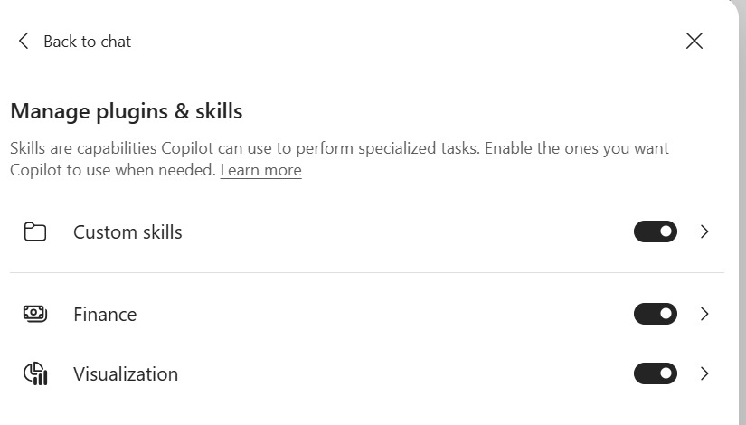
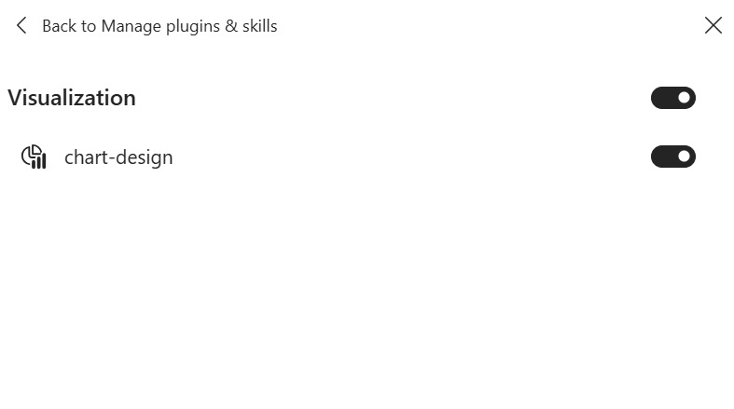
LAB 6 · SCREENSHOT
Built-in Plugins and Custom Skills
Manage plugins & skills
Custom skills holds your uploaded Skills; Finance and Visualization are built-in plugins.
Inside a plugin
Each plugin lists its Skills: Visualization contains chart-design for chart standards.
© Tertiary Infotech Academy Pte Ltd
Enhance Work Productivity with Microsoft 365 Copilot · TGS-2024043856
86

Slide 87
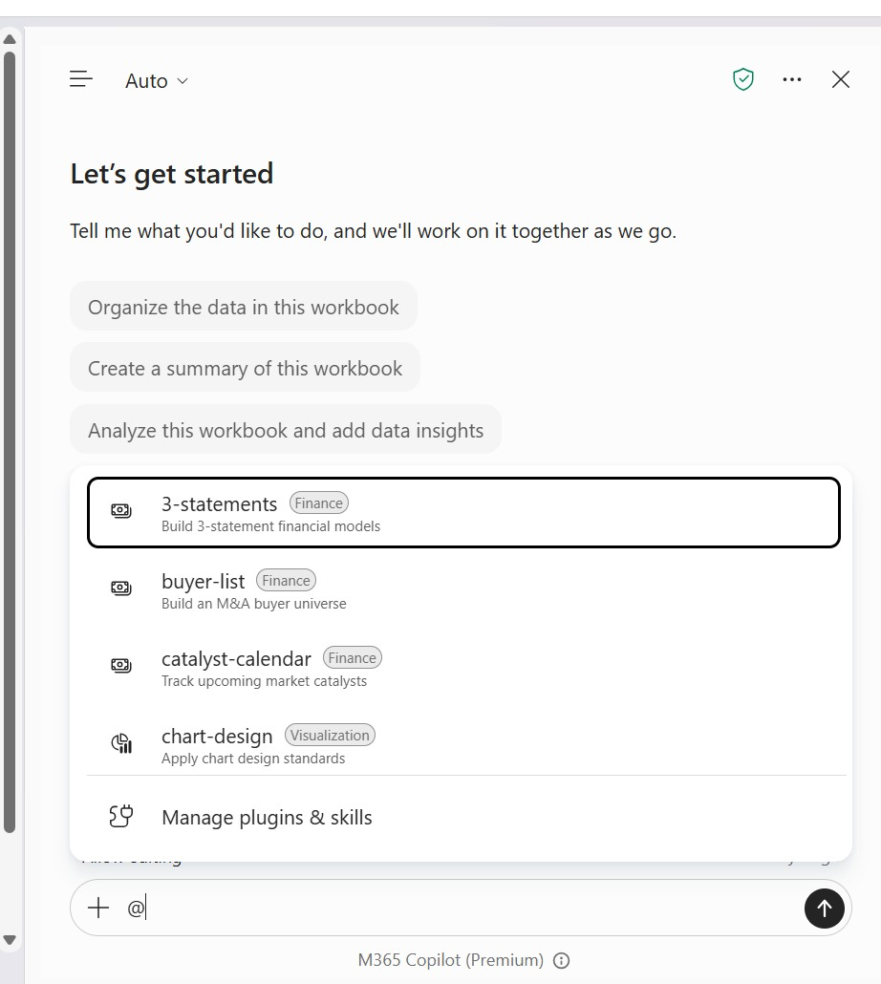
LAB 6 · SCREENSHOT
Invoke a Skill with @
Type @
In the prompt box type @ to list the Skills Copilot can use in this app.
1
Plugin tags
Tags show where each Skill comes from: Finance, Visualization or your custom set.
2
Pick the exact name
Select @hr-case-reporting, then add the source, reporting date and scope.
3
Manage plugins & skills
Open it when the Skill you need is missing or switched off.
4
© Tertiary Infotech Academy Pte Ltd
Enhance Work Productivity with Microsoft 365 Copilot · TGS-2024043856
87

Slide 88
LAB 6 · CONCEPT
Repeatability and Safe Skill Reruns
WHAT IT IS
WHY IT MATTERS
CHECK IT
• Repeatability means the same verified inputs and method yield equivalent business measures and a controlled output structure.
• Reporting skills may be used every week or month, so uncontrolled output accumulation quickly creates conflicting summaries.
• 120 source IDs remain 120 after rerunning HR_Case_Summary.
© Tertiary Infotech Academy Pte Ltd
Enhance Work Productivity with Microsoft 365 Copilot · TGS-2024043856
88

Slide 89
LAB 6 · HOW IT WORKS
Repeatability and Safe Skill Reruns
1
2
3
4
▶
▶
▶
Capture the source fingerprint and outputs.
Request a reviewed rerun plan.
Replace only named output areas.
Compare source and measures again.
© Tertiary Infotech Academy Pte Ltd
Enhance Work Productivity with Microsoft 365 Copilot · TGS-2024043856
89

Slide 90
LAB 6 · HOW TO USE IT
Apply the Concept — Repeatability and Safe Skill Reruns
PROMPT PRINCIPLES
EVIDENCE TO CHECK
• Name the source, reporting date and selected scope.
• Explain the result using checked evidence.
• Missing report date causes a clarification request, not invented numbers.
• A second output sheet is a defect when replacement was requested.
© Tertiary Infotech Academy Pte Ltd
Enhance Work Productivity with Microsoft 365 Copilot · TGS-2024043856
90

Slide 91
LAB 6 · TECHNICAL ANCHOR
Evidence Trace — Repeatability and Safe Skill Reruns
Source
https://support.microsoft.com/en-us/excel/copilot/copilot-in-excel-skills
State
120 source IDs remain 120 after rerunning HR_Case_Summary.
1
2
Check
Missing report date causes a clarification request, not invented numbers.
Boundary
The skill can overwrite source rows or unrelated sheets.
3
4
© Tertiary Infotech Academy Pte Ltd
Enhance Work Productivity with Microsoft 365 Copilot · TGS-2024043856
91

Slide 92
LAB 6 · CONCEPT
Assignment Proposals and Capacity Evidence
WHAT IT IS
WHY IT MATTERS
CHECK IT
• Assignment planning combines the work category, existing owner, estimated hours, HR officer primary category and available hours.
• The same skill can improve Excel analysis and PowerPoint wording by preserving this boundary.
• Unassigned work is counted only within nonterminal statuses.
© Tertiary Infotech Academy Pte Ltd
Enhance Work Productivity with Microsoft 365 Copilot · TGS-2024043856
92

Slide 93
LAB 6 · HOW IT WORKS
Assignment Proposals and Capacity Evidence
1
2
3
4
▶
▶
▶
Identify unassigned backlog.
Compare category and available hours.
Record the proposal and assumptions.
Request the manager decision.
© Tertiary Infotech Academy Pte Ltd
Enhance Work Productivity with Microsoft 365 Copilot · TGS-2024043856
93

Slide 94
LAB 6 · HOW TO USE IT
Apply the Concept — Assignment Proposals and Capacity Evidence
PROMPT PRINCIPLES
EVIDENCE TO CHECK
• Name the source, reporting date and selected scope.
• Explain the result using checked evidence.
• Available hours minus proposed effort is a planning check.
• The source Assigned_To stays unchanged until a real authorised operational update.
© Tertiary Infotech Academy Pte Ltd
Enhance Work Productivity with Microsoft 365 Copilot · TGS-2024043856
94

Slide 95
LAB 6 · TECHNICAL ANCHOR
Evidence Trace — Assignment Proposals and Capacity Evidence
Source
https://support.microsoft.com/en-us/excel/copilot/copilot-in-excel-skills
State
Unassigned work is counted only within nonterminal statuses.
1
2
Check
Available hours minus proposed effort is a planning check.
Boundary
The report claims automatic approval or verified policy competence.
3
4
© Tertiary Infotech Academy Pte Ltd
Enhance Work Productivity with Microsoft 365 Copilot · TGS-2024043856
95

Slide 96
LAB 6 THEME · REPORTING SKILL
Create, Use and Improve the HR Service Reporting Skill
LAB 6
Reuse the Skill-authoring and installation method from Lab 5 to create hr-case-reporting. Apply it in Excel and PowerPoint, test missing inputs and a controlled rerun, then refine v2 using actual evidence.
You'll build
Lumina_Skill_Report.xlsx with HR_Case_Summary and Assignment_Proposals, Lumina_Skill_Update.pptx, SKILL.md v2 and a before/after improvement log.
1 Ground
2 Build
3 Verify
4 Handoff
Tools: Excel and PowerPoint Copilot · Microsoft 365 Copilot web · OneDrive
© Tertiary Infotech Academy Pte Ltd
Enhance Work Productivity with Microsoft 365 Copilot · TGS-2024043856
96

Slide 97
LAB 6 · PROMPTS TO TRY
Sample Prompts — Lab 6
Run Skill: Apply @hr-case-reporting to the verified Lumina snapshot; include total 120, backlog 60, overdue 50, source, scope and limitations.
1
Rerun: Change one filter only, rerun the Skill and reconcile the new result to the unchanged source table.
2
© Tertiary Infotech Academy Pte Ltd
Enhance Work Productivity with Microsoft 365 Copilot · TGS-2024043856
97

Slide 98
LAB 6 · VERIFY
Check Your Results — Lab 6
Source preserved
120 unique cases; current owner/status unchanged.
Skill outputs
Backlog 60; overdue 50; on-time closed 30/48; cost S$35,827.50.
1
2
Improvement evidence
Input guard and rerun tested; v1/v2 retained; PowerPoint four-slide output accurate.
LO2 checkpoint
Four transition stages have owners, evidence, success measures and rollback triggers.
3
4
© Tertiary Infotech Academy Pte Ltd
Enhance Work Productivity with Microsoft 365 Copilot · TGS-2024043856
98

Slide 99
TOPIC RECAP
Recap - Microsoft Copilot for Excel
LO2: Personalisation, .Rules and Skills support controlled transition.
1
Verify: Source, rerun and rollback checks pass.
2
© Tertiary Infotech Academy Pte Ltd
Enhance Work Productivity with Microsoft 365 Copilot · TGS-2024043856
99

Slide 100
TOPIC 3
Create Interactive Dashboard with Microsoft Copilot
Shared-scope measures, refresh tests, evidence story and reviewed handoff
© Tertiary Infotech Academy Pte Ltd
Enhance Work Productivity with Microsoft 365 Copilot · TGS-2024043856
100

Slide 101
KEY CONCEPTS · K2 · A3
Key Concepts — Create Interactive Dashboard with Microsoft Copilot
Dashboard
Six measures and three charts share filter scope.
Refresh
Known deltas in a 122-row sandbox.
1
2
Presentation
Claims trace to the untouched baseline.
Teams and Outlook
Evaluate collaboration with human-send controls.
3
4
© Tertiary Infotech Academy Pte Ltd
Enhance Work Productivity with Microsoft 365 Copilot · TGS-2024043856
101

Slide 102
WHAT YOU'LL DO
Hands-On Labs — Create Interactive Dashboard with Microsoft Copilot
Labs 7–8
Labs 9–10
• Custom Dashboard Skill
– Create and Apply a Custom Interactive Dashboard Skill
• Interactive Filters and Refresh
– Use the Dashboard Skill for Filters, Refresh and Safe Reruns
• Dashboard to presentation
– Turn Dashboard Evidence into a Management Story
• Professional handoff
– Refine and Present the HR Service Decision Deck
© Tertiary Infotech Academy Pte Ltd
Enhance Work Productivity with Microsoft 365 Copilot · TGS-2024043856
102

Slide 103
WORKED DASHBOARD SNAPSHOT
Lumina Portfolio at a Glance
Total cases
Backlog
Overdue
120
60
50
Closed
On-time closed
Recorded cost
48
30/48
S$35,828
Source: synthetic tblHRCases | 30 Sep 2026 | All filters All unless stated
© Tertiary Infotech Academy Pte Ltd
Enhance Work Productivity with Microsoft 365 Copilot · TGS-2024043856
103

Slide 104
NATIVE EDITABLE CHART
Backlog by Department: Count the Nonterminal Work
Source: synthetic tblHRCases | 30 Sep 2026 | All filters All unless stated
© Tertiary Infotech Academy Pte Ltd
Enhance Work Productivity with Microsoft 365 Copilot · TGS-2024043856
104

Slide 105
REUSABLE DASHBOARD METHOD
The Interactive Dashboard Skill Contract
1
2
3
4
▶
▶
▶
Named source + date
Six shared-scope KPIs
Four filters + three charts
Refresh + safe rerun checks
© Tertiary Infotech Academy Pte Ltd
Enhance Work Productivity with Microsoft 365 Copilot · TGS-2024043856
105

Slide 106
LAB 7 · CONCEPT
Custom Dashboard Skill as a Reusable Contract
WHAT IT IS
WHY IT MATTERS
CHECK IT
• hr-case-dashboard is a separate custom Skill whose instructions define inputs, six KPI formulas, four shared filter selectors, three editable charts and controlled output boundaries.
• A reusable contract makes every KPI and chart obey the same AND filter logic and allows a safe refresh using table references.
• Dashboard B2:B5 select department, category, status and owner.
© Tertiary Infotech Academy Pte Ltd
Enhance Work Productivity with Microsoft 365 Copilot · TGS-2024043856
106

Slide 107
LAB 7 · HOW IT WORKS
Custom Dashboard Skill as a Reusable Contract
1
2
3
4
▶
▶
▶
Author and review the complete SKILL.md.
Install and verify the dashboard name.
Invoke a plan and build the reviewed output.
Test common filters, append refresh and reruns.
© Tertiary Infotech Academy Pte Ltd
Enhance Work Productivity with Microsoft 365 Copilot · TGS-2024043856
107

Slide 108
LAB 7 · HOW TO USE IT
Apply the Concept — Custom Dashboard Skill as a Reusable Contract
PROMPT PRINCIPLES
EVIDENCE TO CHECK
• Name the source, reporting date and selected scope.
• Explain the result using checked evidence.
• B7:B12 and all chart summaries use the identical selected rows.
• A 122-row sandbox is separate from the untouched 120-row baseline.
© Tertiary Infotech Academy Pte Ltd
Enhance Work Productivity with Microsoft 365 Copilot · TGS-2024043856
108

Slide 109
LAB 7 · TECHNICAL ANCHOR
Evidence Trace — Custom Dashboard Skill as a Reusable Contract
Source
https://support.microsoft.com/en-us/excel/copilot/copilot-in-excel-skills
State
Dashboard B2:B5 select department, category, status and owner.
1
2
Check
B7:B12 and all chart summaries use the identical selected rows.
Boundary
Tenant Skill access or source preservation is being assumed.
3
4
© Tertiary Infotech Academy Pte Ltd
Enhance Work Productivity with Microsoft 365 Copilot · TGS-2024043856
109

Slide 110
LAB 7 · CONCEPT
Dashboard Measures and Denominators
WHAT IT IS
WHY IT MATTERS
CHECK IT
• A dashboard measure needs a business definition, numerator, denominator where relevant, date rule and filter scope.
• Changing the denominator can make an attractive rate meaningless.
• Closed-only rate is different from closed/total completion share.
© Tertiary Infotech Academy Pte Ltd
Enhance Work Productivity with Microsoft 365 Copilot · TGS-2024043856
110

Slide 111
LAB 7 · HOW IT WORKS
Dashboard Measures and Denominators
1
2
3
4
▶
▶
▶
Define source fields and scope.
Compute count and denominator.
Handle empty selections explicitly.
Reconcile against controls.
© Tertiary Infotech Academy Pte Ltd
Enhance Work Productivity with Microsoft 365 Copilot · TGS-2024043856
111

Slide 112
LAB 7 · HOW TO USE IT
Apply the Concept — Dashboard Measures and Denominators
PROMPT PRINCIPLES
EVIDENCE TO CHECK
• Name the source, reporting date and selected scope.
• Explain the result using checked evidence.
• A due-today backlog item is not overdue under a strict before-date rule.
• All selected status/chart counts reconcile to total selected HR cases.
© Tertiary Infotech Academy Pte Ltd
Enhance Work Productivity with Microsoft 365 Copilot · TGS-2024043856
112

Slide 113
LAB 7 · TECHNICAL ANCHOR
Evidence Trace — Dashboard Measures and Denominators
Source
https://support.microsoft.com/en-us/excel/create-and-share-a-dashboard-with-excel-and-microsoft-groups
State
Closed-only rate is different from closed/total completion share.
1
2
Check
A due-today backlog item is not overdue under a strict before-date rule.
Boundary
A zero denominator is being represented as a measured 0%.
3
4
© Tertiary Infotech Academy Pte Ltd
Enhance Work Productivity with Microsoft 365 Copilot · TGS-2024043856
113

Slide 114
LAB 7 · CONCEPT
Visual Dashboard Design for HR Service
WHAT IT IS
WHY IT MATTERS
CHECK IT
• A dashboard should make an operational decision easier.
• Consistent chart scales, short labels, whitespace and limited accents help a manager compare the work queue quickly.
• Status count chart shows the portfolio mix.
© Tertiary Infotech Academy Pte Ltd
Enhance Work Productivity with Microsoft 365 Copilot · TGS-2024043856
114

Slide 115
LAB 7 · HOW IT WORKS
Visual Dashboard Design for HR Service
1
2
3
4
▶
▶
▶
Name the HR service decision.
Choose the measure and comparison.
Use an appropriate labelled chart.
Check meaning and readability.
© Tertiary Infotech Academy Pte Ltd
Enhance Work Productivity with Microsoft 365 Copilot · TGS-2024043856
115

Slide 116
LAB 7 · HOW TO USE IT
Apply the Concept — Visual Dashboard Design for HR Service
PROMPT PRINCIPLES
EVIDENCE TO CHECK
• Name the source, reporting date and selected scope.
• Explain the result using checked evidence.
• Department backlog chart excludes Closed and Cancelled.
• A category count does not establish the root cause of overdue cases.
© Tertiary Infotech Academy Pte Ltd
Enhance Work Productivity with Microsoft 365 Copilot · TGS-2024043856
116

Slide 117
LAB 7 · TECHNICAL ANCHOR
Evidence Trace — Visual Dashboard Design for HR Service
Source
https://support.microsoft.com/en-us/excel/create-and-share-a-dashboard-with-excel-and-microsoft-groups
State
Status count chart shows the portfolio mix.
1
2
Check
Department backlog chart excludes Closed and Cancelled.
Boundary
Decorative charts hide an ambiguous metric.
3
4
© Tertiary Infotech Academy Pte Ltd
Enhance Work Productivity with Microsoft 365 Copilot · TGS-2024043856
117

Slide 118
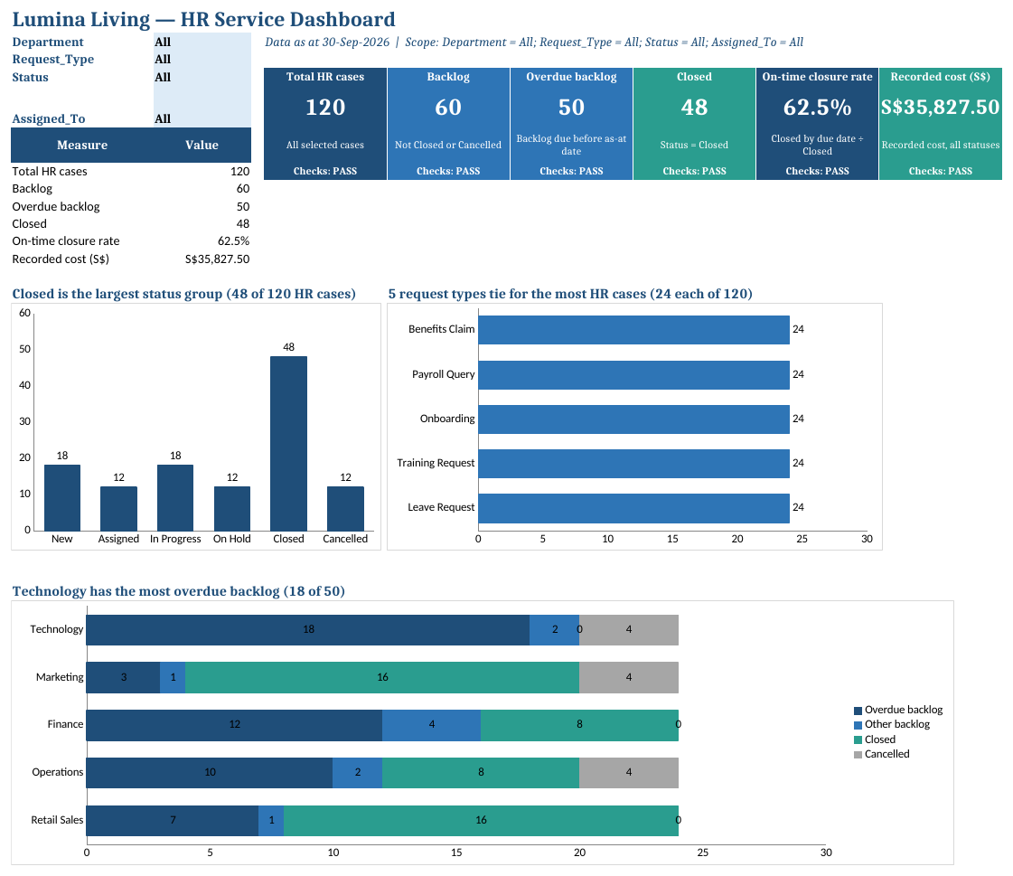
LAB 7 · SCREENSHOT
What Is an Interactive Dashboard?
Filters (B2:B5)
Department, Request_Type, Status and Assigned_To. All includes everything; choices combine with AND.
1
Scope line
States the as-at date and the active filters, so every reader knows what is shown.
2
KPI tiles
Six measures from the same selected rows; Checks: PASS confirms chart totals match.
3
Finding titles
Each chart title is a formula that states the result, e.g. which department has most overdue cases.
4
Linked charts
Status, request type and department charts all read the same filtered rows.
5
© Tertiary Infotech Academy Pte Ltd
Enhance Work Productivity with Microsoft 365 Copilot · TGS-2024043856
118

Slide 119
LAB 7 THEME · CUSTOM DASHBOARD SKILL
Create and Apply a Custom Interactive Dashboard Skill
LAB 7
Create hr-case-dashboard/SKILL.md for the Lumina HR service workflow, install it in Excel, then invoke it to plan and build an interactive dashboard. Six KPIs and three charts share four filter selections.
You'll build
Lumina_Dashboard.xlsx with a Dashboard layout, six verified measures, three labelled charts and a measure dictionary ready for Lab 8 filters.
1 Ground
2 Build
3 Verify
4 Handoff
Tools: Excel Copilot · Microsoft 365 Copilot web · OneDrive
© Tertiary Infotech Academy Pte Ltd
Enhance Work Productivity with Microsoft 365 Copilot · TGS-2024043856
119

Slide 120
LAB 7 · PROMPTS TO TRY
Sample Prompts — Lab 7
Build: Apply @hr-case-dashboard to Lumina_HR_Cases.xlsx using six KPIs, Department/Category/Status/Owner filters and three editable chart summaries.
1
Verify: At All filters confirm total 120, backlog 60, overdue 50, closed 48, on-time rate 62.5% and recorded cost SGD 35,827.50.
2
© Tertiary Infotech Academy Pte Ltd
Enhance Work Productivity with Microsoft 365 Copilot · TGS-2024043856
120

Slide 121
LAB 7 · VERIFY
Check Your Results — Lab 7
Baseline
Total 120; backlog 60; overdue 50; closed 48.
SLA and cost
30/48 = 62.5%; S$35,827.50.
1
2
Chart reconciliation
Three count summaries each total 120; formulas reference tblHRCases.
Decision design
Measures dictionary and source/date visible; no unsupported cause claims.
3
4
© Tertiary Infotech Academy Pte Ltd
Enhance Work Productivity with Microsoft 365 Copilot · TGS-2024043856
121

Slide 122
EDITABLE WORKED COMPARISON
Same Data, Different Filter Scope
All departments
Retail Sales
Total: 120
Total: 24
Backlog: 60
Backlog: 8
Overdue: 50
Overdue: 7
Closed: 48
Closed: 16
On-time closed: 30/48
On-time closed: 10/16
Source: synthetic tblHRCases | 30 Sep 2026 | All filters All unless stated
© Tertiary Infotech Academy Pte Ltd
Enhance Work Productivity with Microsoft 365 Copilot · TGS-2024043856
122

Slide 123
LAB 8 · CONCEPT
One Filter Scope for Every Visual
WHAT IT IS
WHY IT MATTERS
CHECK IT
• Interactive means a learner-controlled selection changes the evidence shown.
• A dashboard can appear interactive while only one chart changes.
• Retail Sales plus All in other selectors isolates that department.
© Tertiary Infotech Academy Pte Ltd
Enhance Work Productivity with Microsoft 365 Copilot · TGS-2024043856
123

Slide 124
LAB 8 · HOW IT WORKS
One Filter Scope for Every Visual
1
2
3
4
▶
▶
▶
Define the selector cells.
Apply the same AND mask everywhere.
Test each control and edge case.
Reconcile selected chart and KPI totals.
© Tertiary Infotech Academy Pte Ltd
Enhance Work Productivity with Microsoft 365 Copilot · TGS-2024043856
124

Slide 125
LAB 8 · HOW TO USE IT
Apply the Concept — One Filter Scope for Every Visual
PROMPT PRINCIPLES
EVIDENCE TO CHECK
• Name the source, reporting date and selected scope.
• Explain the result using checked evidence.
• Status New gives zero Closed and N/A closure rate.
• A slicer must connect to every intended PivotTable.
© Tertiary Infotech Academy Pte Ltd
Enhance Work Productivity with Microsoft 365 Copilot · TGS-2024043856
125

Slide 126
LAB 8 · TECHNICAL ANCHOR
Evidence Trace — One Filter Scope for Every Visual
Source
https://support.microsoft.com/en-us/excel/get-started/use-slicers-to-filter-data
State
Retail Sales plus All in other selectors isolates that department.
1
2
Check
Status New gives zero Closed and N/A closure rate.
Boundary
A selector only changes a decorative title or one chart.
3
4
© Tertiary Infotech Academy Pte Ltd
Enhance Work Productivity with Microsoft 365 Copilot · TGS-2024043856
126

Slide 127
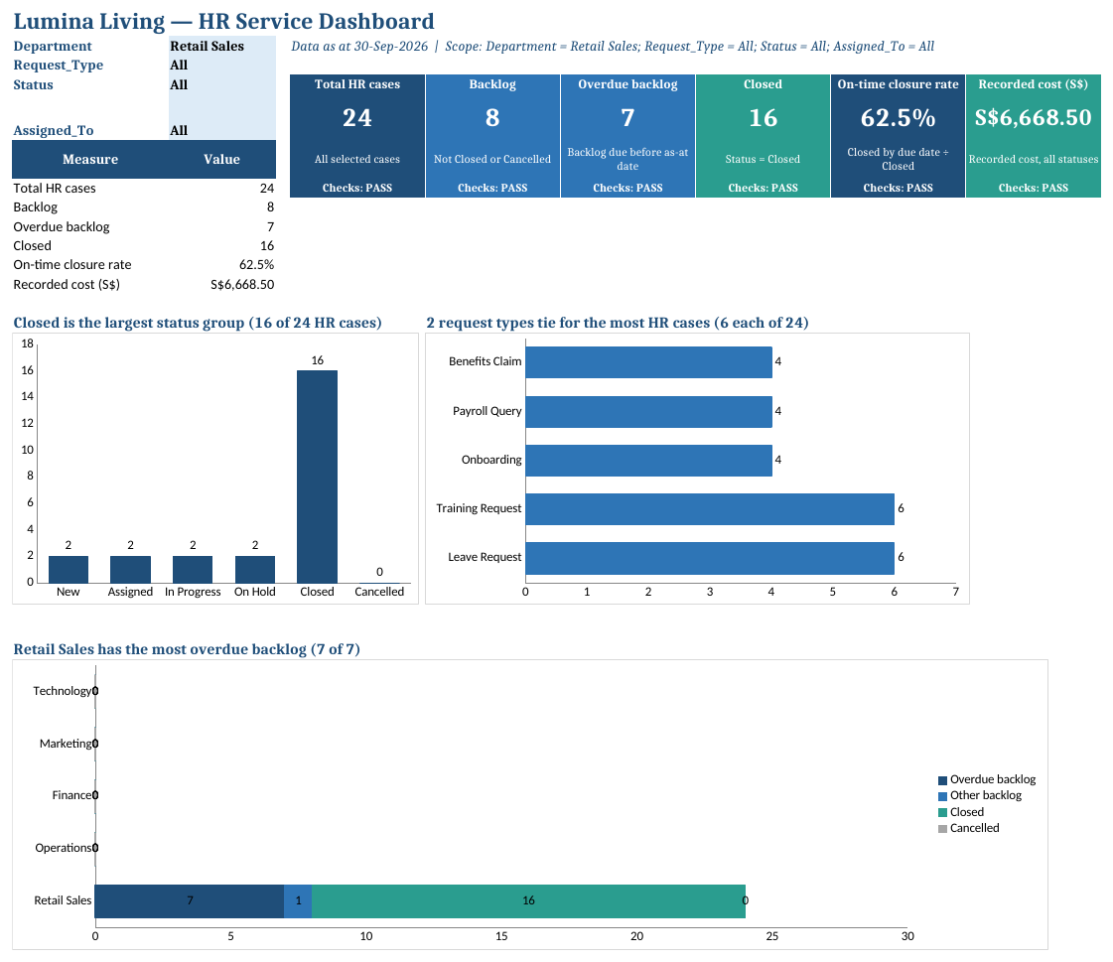
LAB 8 · SCREENSHOT
Interactive: One Filter Changes Everything
Department = All
120 HR cases · backlog 60 · overdue 50 · 48 closed · S$35,827.50 recorded cost.
Department = Retail Sales
Every tile, title and chart recalculates: 24 cases · backlog 8 · overdue 7 · S$6,668.50.
© Tertiary Infotech Academy Pte Ltd
Enhance Work Productivity with Microsoft 365 Copilot · TGS-2024043856
127

Slide 128
LAB 8 · CONCEPT
Refresh Tests and Static Snapshots
WHAT IT IS
WHY IT MATTERS
CHECK IT
• A refresh test deliberately introduces known new records and verifies the expected delta.
• A correct dashboard today may fail after the next export if formulas reference a fixed cell range.
• Two test rows increase total by 2 and recorded cost by S$400.
© Tertiary Infotech Academy Pte Ltd
Enhance Work Productivity with Microsoft 365 Copilot · TGS-2024043856
128

Slide 129
LAB 8 · HOW IT WORKS
Refresh Tests and Static Snapshots
1
2
3
4
▶
▶
▶
Save an isolated sandbox copy.
Append known unique test rows.
Recalculate and verify expected deltas.
Handoff the untouched baseline.
© Tertiary Infotech Academy Pte Ltd
Enhance Work Productivity with Microsoft 365 Copilot · TGS-2024043856
129

Slide 130
LAB 8 · HOW TO USE IT
Apply the Concept — Refresh Tests and Static Snapshots
PROMPT PRINCIPLES
EVIDENCE TO CHECK
• Name the source, reporting date and selected scope.
• Explain the result using checked evidence.
• Only one new row adds to backlog/overdue; the other adds to on-time Closed.
• The final deck uses the untouched 120-row baseline, not the test copy.
© Tertiary Infotech Academy Pte Ltd
Enhance Work Productivity with Microsoft 365 Copilot · TGS-2024043856
130

Slide 131
LAB 8 · TECHNICAL ANCHOR
Evidence Trace — Refresh Tests and Static Snapshots
Source
https://support.microsoft.com/en-us/excel/create-and-share-a-dashboard-with-excel-and-microsoft-groups
State
Two test rows increase total by 2 and recorded cost by S$400.
1
2
Check
Only one new row adds to backlog/overdue; the other adds to on-time Closed.
Boundary
Test rows are being mixed into the report without disclosure.
3
4
© Tertiary Infotech Academy Pte Ltd
Enhance Work Productivity with Microsoft 365 Copilot · TGS-2024043856
131

Slide 132
LAB 8 THEME · INTERACTIVE FILTERS AND REFRESH
Use the Dashboard Skill for Filters, Refresh and Safe Reruns
LAB 8
Continue Lab 7 by making four dropdown selectors control every KPI and chart. Test a single department, a zero-denominator selection and a combined category/owner filter.
You'll build
Lumina_Dashboard.xlsx with four working filters plus Lumina_Dashboard_Refresh_Test.xlsx, filter evidence and a verified baseline snapshot for PowerPoint.
1 Ground
2 Build
3 Verify
4 Handoff
Tools: Excel Copilot · Microsoft 365 Copilot web · OneDrive
© Tertiary Infotech Academy Pte Ltd
Enhance Work Productivity with Microsoft 365 Copilot · TGS-2024043856
132

Slide 133
LAB 8 · PROMPTS TO TRY
Sample Prompts — Lab 8
Refresh: Append Refresh_Test_Rows.csv in the sandbox, refresh @hr-case-dashboard and verify total 122, backlog 61, overdue 51 and closed 49.
1
Empty scope: Filter Retail Sales, Leave Request and Daniel Lee; show an explicit empty state rather than a zero-data chart.
2
© Tertiary Infotech Academy Pte Ltd
Enhance Work Productivity with Microsoft 365 Copilot · TGS-2024043856
133

Slide 134
LAB 8 · VERIFY
Check Your Results — Lab 8
Retail Sales control
Total 24; backlog 8; overdue 7; closed 16; cost S$6,668.50; on-time 10/16.
Interactive scope
Changing any of four filters affects all six KPI measures and all chart counts.
1
2
Edge case
No Closed -> N/A; no rows -> zero count/cost and N/A rate.
Refresh sandbox
122 total;49 closed;61 backlog;51 overdue;S$36,227.50;31/49 on-time.
3
4
Handoff baseline
Return to 120-row untouched baseline; date and All scope recorded.
5
© Tertiary Infotech Academy Pte Ltd
Enhance Work Productivity with Microsoft 365 Copilot · TGS-2024043856
134

Slide 135
EVIDENCE TO NARRATIVE
A Verified Chart Becomes a Decision
1
2
3
4
▶
▶
▶
Observed backlog
Operational implication
Proposed recovery action
Manager decision requested
© Tertiary Infotech Academy Pte Ltd
Enhance Work Productivity with Microsoft 365 Copilot · TGS-2024043856
135

Slide 136
LAB 9 · CONCEPT
From Dashboard Evidence to a Decision Story
WHAT IT IS
WHY IT MATTERS
CHECK IT
• A management presentation transforms evidence into a sequence of observations, implications, proposed actions and a decision request.
• Copilot can accelerate outlines and drafting, but a persuasive invented conclusion is still wrong.
• Backlog by department supports prioritisation, not a proven cause.
© Tertiary Infotech Academy Pte Ltd
Enhance Work Productivity with Microsoft 365 Copilot · TGS-2024043856
136

Slide 137
LAB 9 · HOW IT WORKS
From Dashboard Evidence to a Decision Story
1
2
3
4
▶
▶
▶
Freeze the verified dashboard snapshot.
Register each proposed claim.
Write a reviewed Word brief.
Generate and reconcile the deck.
© Tertiary Infotech Academy Pte Ltd
Enhance Work Productivity with Microsoft 365 Copilot · TGS-2024043856
137

Slide 138
LAB 9 · HOW TO USE IT
Apply the Concept — From Dashboard Evidence to a Decision Story
PROMPT PRINCIPLES
EVIDENCE TO CHECK
• Name the source, reporting date and selected scope.
• Explain the result using checked evidence.
• Available-hours evidence supports a capacity discussion, not confirmed allocation.
• The final slide asks management to decide on a proposed plan.
© Tertiary Infotech Academy Pte Ltd
Enhance Work Productivity with Microsoft 365 Copilot · TGS-2024043856
138

Slide 139
LAB 9 · TECHNICAL ANCHOR
Evidence Trace — From Dashboard Evidence to a Decision Story
Source
https://support.microsoft.com/en-gb/word/copilot/draft-and-add-content-with-copilot-in-word
State
Backlog by department supports prioritisation, not a proven cause.
1
2
Check
Available-hours evidence supports a capacity discussion, not confirmed allocation.
Boundary
The story introduces savings, causes or approvals absent from evidence.
3
4
© Tertiary Infotech Academy Pte Ltd
Enhance Work Productivity with Microsoft 365 Copilot · TGS-2024043856
139

Slide 140
LAB 9 · CONCEPT
Charts, Templates and Source Provenance
WHAT IT IS
WHY IT MATTERS
CHECK IT
• A template supplies slide layouts, typography and colours; it does not supply correct facts.
• Approximate AI-generated charts can contradict source values while looking plausible.
• An editable embedded chart remains a copy rather than a tested live link.
© Tertiary Infotech Academy Pte Ltd
Enhance Work Productivity with Microsoft 365 Copilot · TGS-2024043856
140

Slide 141
LAB 9 · HOW IT WORKS
Charts, Templates and Source Provenance
1
2
3
4
▶
▶
▶
Select the reviewed brief.
Apply the existing template.
Insert verified charts or tables.
Record source and snapshot scope.
© Tertiary Infotech Academy Pte Ltd
Enhance Work Productivity with Microsoft 365 Copilot · TGS-2024043856
141

Slide 142
LAB 9 · HOW TO USE IT
Apply the Concept — Charts, Templates and Source Provenance
PROMPT PRINCIPLES
EVIDENCE TO CHECK
• Name the source, reporting date and selected scope.
• Explain the result using checked evidence.
• An image is labelled as a snapshot at 30 September.
• All eight slides use one reviewed baseline.
© Tertiary Infotech Academy Pte Ltd
Enhance Work Productivity with Microsoft 365 Copilot · TGS-2024043856
142

Slide 143
LAB 9 · TECHNICAL ANCHOR
Evidence Trace — Charts, Templates and Source Provenance
Source
https://support.microsoft.com/en-us/powerpoint/copilot/add-a-slide-from-a-file-with-copilot-in-powerpoint
State
An editable embedded chart remains a copy rather than a tested live link.
1
2
Check
An image is labelled as a snapshot at 30 September.
Boundary
A visual is assumed accurate because Copilot produced it.
3
4
© Tertiary Infotech Academy Pte Ltd
Enhance Work Productivity with Microsoft 365 Copilot · TGS-2024043856
143

Slide 144
LAB 9 THEME · DASHBOARD TO PRESENTATION
Turn Dashboard Evidence into a Management Story
LAB 9
Continue the baseline dashboard from Topic 3. Build a slide evidence register and a Word presentation brief before asking PowerPoint Copilot for an eight-slide management deck.
You'll build
Lumina_Presentation_Brief.docx, Lumina_HR_Management_Draft.pptx and a slide-by-slide evidence register tied to the 120-row dashboard snapshot.
1 Ground
2 Build
3 Verify
4 Handoff
Tools: Microsoft 365 Copilot · Excel · Word · PowerPoint · Outlook · OneDrive
© Tertiary Infotech Academy Pte Ltd
Enhance Work Productivity with Microsoft 365 Copilot · TGS-2024043856
144

Slide 145
LAB 9 · PROMPTS TO TRY
Sample Prompts — Lab 9
Story: Using the verified dashboard snapshot, outline an eight-slide Lumina management story with claim, value, source, scope, as-at date and limitation for each slide.
1
Outlook: Draft an unsent Outlook review request that names the deck version and asks the HR manager to confirm proposed assignments.
2
© Tertiary Infotech Academy Pte Ltd
Enhance Work Productivity with Microsoft 365 Copilot · TGS-2024043856
145

Slide 146
LAB 9 · VERIFY
Check Your Results — Lab 9
Evidence continuity
Every deck figure maps to the 120-row Lab 8 baseline and slide evidence register.
Eight-slide narrative
Observation -> implication -> proposed action -> decision; no invented cause/savings.
1
2
Chart semantics
Backlog charts exclude Closed/Cancelled; embedded/image copies labelled snapshot.
3
© Tertiary Infotech Academy Pte Ltd
Enhance Work Productivity with Microsoft 365 Copilot · TGS-2024043856
146

Slide 147
ARTIFACT LIFECYCLE
The HR Service Reporting Handoff
1
2
3
4
▶
▶
▶
Interactive workbook
Dated Word evidence
Static PPTX + PDF
Reviewed unsent email
© Tertiary Infotech Academy Pte Ltd
Enhance Work Productivity with Microsoft 365 Copilot · TGS-2024043856
147

Slide 148
LAB 10 · CONCEPT
Professional Refinement and Rehearsal
WHAT IT IS
WHY IT MATTERS
CHECK IT
• Refinement improves the clarity of the existing evidence without changing its meaning.
• A well-designed deck can still fail when the speaker’s notes contain different numbers or a proposal is spoken as an approved action.
• One message per slide; chart labels remain readable.
© Tertiary Infotech Academy Pte Ltd
Enhance Work Productivity with Microsoft 365 Copilot · TGS-2024043856
148

Slide 149
LAB 10 · HOW IT WORKS
Professional Refinement and Rehearsal
1
2
3
4
▶
▶
▶
Audit the draft against evidence.
Apply reviewed design changes.
Rehearse and record actual feedback.
Inspect PPTX and exported PDF.
© Tertiary Infotech Academy Pte Ltd
Enhance Work Productivity with Microsoft 365 Copilot · TGS-2024043856
149

Slide 150
LAB 10 · HOW TO USE IT
Apply the Concept — Professional Refinement and Rehearsal
PROMPT PRINCIPLES
EVIDENCE TO CHECK
• Name the source, reporting date and selected scope.
• Explain the result using checked evidence.
• A 45-second note explains evidence and limitation.
• Partner feedback leads to one recorded revision.
© Tertiary Infotech Academy Pte Ltd
Enhance Work Productivity with Microsoft 365 Copilot · TGS-2024043856
150

Slide 151
LAB 10 · TECHNICAL ANCHOR
Evidence Trace — Professional Refinement and Rehearsal
Source
https://support.microsoft.com/en-us/powerpoint/copilot/copilot-in-powerpoint-skills
State
One message per slide; chart labels remain readable.
1
2
Check
A 45-second note explains evidence and limitation.
Boundary
Polish hides an unsupported claim or unreadable chart.
3
4
© Tertiary Infotech Academy Pte Ltd
Enhance Work Productivity with Microsoft 365 Copilot · TGS-2024043856
151

Slide 152
LAB 10 · CONCEPT
Reviewed Handoff and Artifact Lifecycle
WHAT IT IS
WHY IT MATTERS
CHECK IT
• The final pack contains an interactive Excel dashboard, a fixed reporting brief, a static PowerPoint/PDF snapshot, the custom skill and a reviewed communication draft.
• Updating one artifact without the others creates inconsistent communication.
• PowerPoint and PDF both show eight slides/pages from the same baseline.
© Tertiary Infotech Academy Pte Ltd
Enhance Work Productivity with Microsoft 365 Copilot · TGS-2024043856
152

Slide 153
LAB 10 · HOW IT WORKS
Reviewed Handoff and Artifact Lifecycle
1
2
3
4
▶
▶
▶
Reconcile final artifacts.
Record actual filenames and links.
Review the handoff draft.
Preserve the dated snapshot and skill.
© Tertiary Infotech Academy Pte Ltd
Enhance Work Productivity with Microsoft 365 Copilot · TGS-2024043856
153

Slide 154
LAB 10 · HOW TO USE IT
Apply the Concept — Reviewed Handoff and Artifact Lifecycle
PROMPT PRINCIPLES
EVIDENCE TO CHECK
• Name the source, reporting date and selected scope.
• Explain the result using checked evidence.
• Outlook does not claim a missing attachment was sent.
• The next update reruns the method with new verified inputs.
© Tertiary Infotech Academy Pte Ltd
Enhance Work Productivity with Microsoft 365 Copilot · TGS-2024043856
154

Slide 155
LAB 10 · TECHNICAL ANCHOR
Evidence Trace — Reviewed Handoff and Artifact Lifecycle
Source
https://support.microsoft.com/en-us/microsoft-365-copilot/file-formats-supported-by-microsoft-365-copilot
State
PowerPoint and PDF both show eight slides/pages from the same baseline.
1
2
Check
Outlook does not claim a missing attachment was sent.
Boundary
A refreshed dashboard is assumed to rewrite an old presentation.
3
4
© Tertiary Infotech Academy Pte Ltd
Enhance Work Productivity with Microsoft 365 Copilot · TGS-2024043856
155

Slide 156
LAB 10 THEME · PROFESSIONAL HANDOFF
Refine and Present the HR Service Decision Deck
LAB 10
Refine the management deck using the same custom skill and reviewed dashboard evidence. Improve hierarchy, consistency and speaker notes, test the story in a short rehearsal, and prepare a reviewed Outlook handoff draft.
You'll build
Lumina_HR_Management_Final.pptx/PDF, a rehearsal record, final evidence register and unsent Outlook handoff draft with accurate artifact links.
1 Ground
2 Build
3 Verify
4 Handoff
Tools: Microsoft 365 Copilot · Excel · Word · PowerPoint · Outlook · OneDrive
© Tertiary Infotech Academy Pte Ltd
Enhance Work Productivity with Microsoft 365 Copilot · TGS-2024043856
156

Slide 157
LAB 10 · PROMPTS TO TRY
Sample Prompts — Lab 10
Refine: Refine Lumina_HR_Decision_Deck.pptx for readable titles, editable charts, source notes and a clear current-versus-proposed assignment boundary.
1
Rehearse: Use Rehearsal_Log.csv to record feedback, evidence, change and retest before the final handoff.
2
© Tertiary Infotech Academy Pte Ltd
Enhance Work Productivity with Microsoft 365 Copilot · TGS-2024043856
157

Slide 158
LAB 10 · VERIFY
Check Your Results — Lab 10
Presentation integrity
Eight slides and eight PDF pages; visible figures agree with verified register.
Professional delivery
Readable chart labels, consistent design, evidence-specific notes and actual rehearsal improvement.
1
2
Final continuity
Baseline dashboard, brief, deck and unsent draft agree; static snapshot stated.
Decision boundary
No real email sent or HR case reassigned; proposed actions remain proposed.
3
4
LO3 checkpoint
Outlook and Teams rows use supplied evidence, observable value, readiness, risk/control and a human gate.
5
© Tertiary Infotech Academy Pte Ltd
Enhance Work Productivity with Microsoft 365 Copilot · TGS-2024043856
158

Slide 159
TOPIC RECAP
Recap - Create Interactive Dashboard with Microsoft Copilot
LO3: Dashboard and presentation support evaluation of Copilot opportunities.
1
Verify: Claims use untouched fixed-date baseline.
2
© Tertiary Infotech Academy Pte Ltd
Enhance Work Productivity with Microsoft 365 Copilot · TGS-2024043856
159

Slide 160
TOPIC 4
Create Microsoft Agent
Build a grounded HR agent: scope, knowledge, Skill, tests, sharing and staff enablement
© Tertiary Infotech Academy Pte Ltd
Enhance Work Productivity with Microsoft 365 Copilot · TGS-2024043856
160

Slide 161
KEY CONCEPTS · K4 · A4
Key Concepts — Create Microsoft Agent
Boundary
HR helpdesk answers; no approvals, sends or record changes.
Knowledge
Permission-aware HR handbook and verified case snapshot.
1
2
Skill
hr-policy-qa sets format, citations and privacy rules.
Evaluation
Known-answer, privacy and guardrail tests before named-user sharing.
3
4
© Tertiary Infotech Academy Pte Ltd
Enhance Work Productivity with Microsoft 365 Copilot · TGS-2024043856
161

Slide 162
WHAT YOU'LL DO
Hands-On Labs — Create Microsoft Agent
Labs 11–12
Labs 13–14
• Agent Scope and Knowledge
– Design the HR Policy Agent: Users, Knowledge and Skill
• Agent Configuration
– Build the HR Agent: Instructions, Knowledge, Skill and Starter Prompts
• Agent Test and Evaluation
– Test Grounded HR Answers, Citations and Guardrails
• Governed Sharing and Enablement
– Share the HR Agent with Named Users and Deliver Staff Enablement
© Tertiary Infotech Academy Pte Ltd
Enhance Work Productivity with Microsoft 365 Copilot · TGS-2024043856
162

Slide 163
LAB 11 · CONCEPT
An HR Agent Answers from Approved Knowledge
WHAT IT IS
WHY IT MATTERS
CHECK IT
• Agent Builder creates declarative agents for focused retrieval and drafting in Microsoft 365 Copilot.
• A precise boundary keeps a helpful HR assistant from being mistaken for an approval system or a source of other people’s data.
• Annual leave answer cites section 1
© Tertiary Infotech Academy Pte Ltd
Enhance Work Productivity with Microsoft 365 Copilot · TGS-2024043856
163

Slide 164
LAB 11 · HOW IT WORKS
An HR Agent Answers from Approved Knowledge
1
2
3
4
▶
▶
▶
Name users and questions
List approved knowledge
State refused requests
Define success and escalation
© Tertiary Infotech Academy Pte Ltd
Enhance Work Productivity with Microsoft 365 Copilot · TGS-2024043856
164

Slide 165
LAB 11 · HOW TO USE IT
Apply the Agent Control — An HR Agent Answers from Approved Knowledge
CONFIGURATION PRINCIPLE
EVIDENCE TO CHECK
• Name the intended user, permitted knowledge and response boundary.
• State the test evidence that proves this behaviour.
• No approvals, sends or record changes
• HR Business Partner handles UNKNOWN
© Tertiary Infotech Academy Pte Ltd
Enhance Work Productivity with Microsoft 365 Copilot · TGS-2024043856
165

Slide 166
LAB 11 · TECHNICAL ANCHOR
Evidence Trace — An HR Agent Answers from Approved Knowledge
Source
https://learn.microsoft.com/en-us/microsoft-365-copilot/extensibility/agent-builder
State
Annual leave answer cites section 1
1
2
Check
No approvals, sends or record changes
Boundary
The task needs approvals, live HR records or another employee’s data.
3
4
© Tertiary Infotech Academy Pte Ltd
Enhance Work Productivity with Microsoft 365 Copilot · TGS-2024043856
166

Slide 167
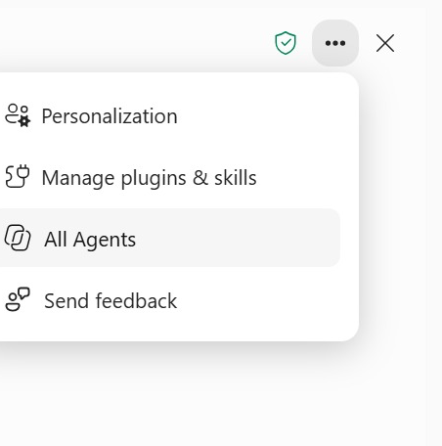
LAB 11 · SCREENSHOT
Find Your Agents — ••• > All Agents
Personalization
Account-level preferences from Lab 3; they apply to you, not to the agent.
1
Manage plugins & skills
Skills from Labs 5–7; an agent carries its own Skills, such as hr-policy-qa.
2
All Agents
Lists agents available to you, including the Lumina HR Policy Agent once shared.
3
Send feedback
Report a wrong or unsafe answer, and also log it in your agent test matrix.
4
© Tertiary Infotech Academy Pte Ltd
Enhance Work Productivity with Microsoft 365 Copilot · TGS-2024043856
167

Slide 168
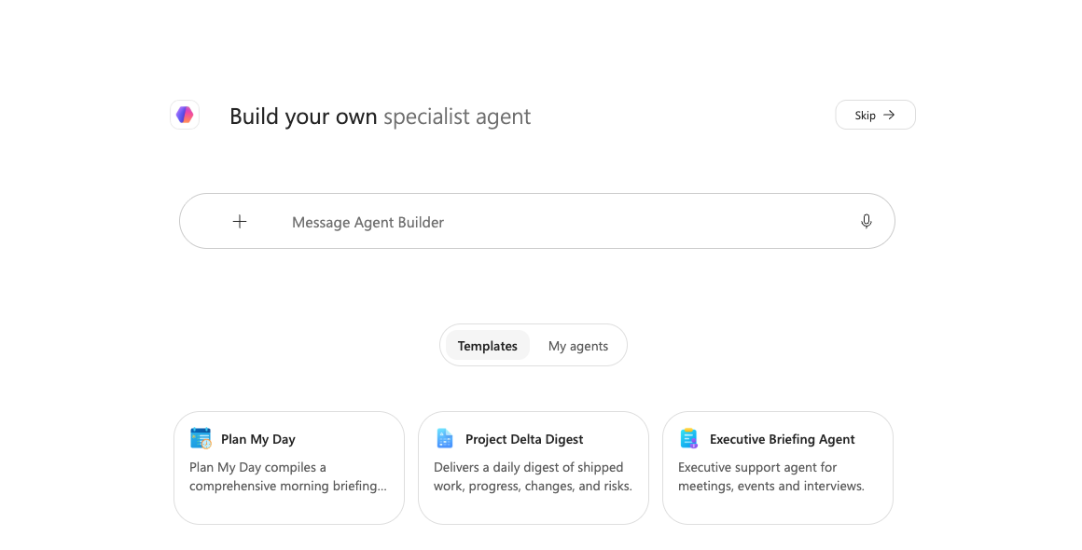
LAB 11 · SCREENSHOT
Agents > New Agent Opens Agent Builder
1
Describe it
Tell Agent Builder in plain language what the agent should do; it drafts a configuration for you to review.
2
Skip
Goes straight to the Configure form; Lab 12 fills it from the reviewed HR agent specification.
3
Templates / My agents
Start from a template or reopen an agent you built; My agents lists your own.
4
+ sources
Attach the approved knowledge files while you describe the agent.
© Tertiary Infotech Academy Pte Ltd
Enhance Work Productivity with Microsoft 365 Copilot · TGS-2024043856
168

Slide 169
LAB 11 · CONCEPT
Knowledge Inventory and Permission Model
WHAT IT IS
WHY IT MATTERS
CHECK IT
• Knowledge can include SharePoint, OneDrive, embedded files and other licensed sources.
• Owner success can hide user-access failure.
• Existing permissions stay in force
© Tertiary Infotech Academy Pte Ltd
Enhance Work Productivity with Microsoft 365 Copilot · TGS-2024043856
169

Slide 170
LAB 11 · HOW IT WORKS
Knowledge Inventory and Permission Model
1
2
3
4
▶
▶
▶
Inventory sources
Record owner and date
Check user permission
Test as a representative user
© Tertiary Infotech Academy Pte Ltd
Enhance Work Productivity with Microsoft 365 Copilot · TGS-2024043856
170

Slide 171
LAB 11 · HOW TO USE IT
Apply the Agent Control — Knowledge Inventory and Permission Model
CONFIGURATION PRINCIPLE
EVIDENCE TO CHECK
• Name the intended user, permitted knowledge and response boundary.
• State the test evidence that proves this behaviour.
• Restricted case notes are excluded
• A local path is not cloud knowledge
© Tertiary Infotech Academy Pte Ltd
Enhance Work Productivity with Microsoft 365 Copilot · TGS-2024043856
171

Slide 172
LAB 11 · TECHNICAL ANCHOR
Evidence Trace — Knowledge Inventory and Permission Model
Source
https://learn.microsoft.com/en-us/microsoft-365-copilot/extensibility/copilot-studio-lite-knowledge
State
Existing permissions stay in force
1
2
Check
Restricted case notes are excluded
Boundary
Ownership or intended-user access is unknown.
3
4
© Tertiary Infotech Academy Pte Ltd
Enhance Work Productivity with Microsoft 365 Copilot · TGS-2024043856
172

Slide 173
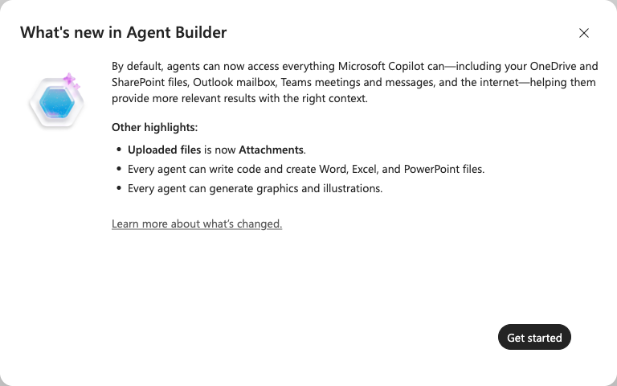
LAB 11 · SCREENSHOT
Default Access Is Broad — Narrow It on Purpose
Everything by default
New agents can reach OneDrive, SharePoint, your mailbox, Teams and the web, the same as Copilot.
1
Why it matters
An HR policy agent must answer only from the approved handbook (AI Security principle 2: permission control).
2
What you do
In Lab 12, add the handbook as knowledge and switch off the broad sources before testing.
3
© Tertiary Infotech Academy Pte Ltd
Enhance Work Productivity with Microsoft 365 Copilot · TGS-2024043856
173

Slide 174
LAB 11 · CONCEPT
Skills Shape Every Agent Answer
WHAT IT IS
WHY IT MATTERS
CHECK IT
• A Skill is a reusable SKILL.md instruction package.
• Without a consistent method, two correct sources can still produce uncited, over-confident or privacy-breaking answers.
• Answer, conditions, next step, Sources
© Tertiary Infotech Academy Pte Ltd
Enhance Work Productivity with Microsoft 365 Copilot · TGS-2024043856
174

Slide 175
LAB 11 · HOW IT WORKS
Skills Shape Every Agent Answer
1
2
3
4
▶
▶
▶
Write the Skill rules
Check them against the handbook
Compress the folder to .zip
Upload and verify it is enabled
© Tertiary Infotech Academy Pte Ltd
Enhance Work Productivity with Microsoft 365 Copilot · TGS-2024043856
175

Slide 176
LAB 11 · HOW TO USE IT
Apply the Agent Control — Skills Shape Every Agent Answer
CONFIGURATION PRINCIPLE
EVIDENCE TO CHECK
• Name the intended user, permitted knowledge and response boundary.
• State the test evidence that proves this behaviour.
• UNKNOWN plus HR Business Partner referral
• Never reveal another employee’s data
© Tertiary Infotech Academy Pte Ltd
Enhance Work Productivity with Microsoft 365 Copilot · TGS-2024043856
176

Slide 177
LAB 11 · TECHNICAL ANCHOR
Evidence Trace — Skills Shape Every Agent Answer
Source
https://learn.microsoft.com/en-us/microsoft-365-copilot/extensibility/agent-builder-build-agents
State
Answer, conditions, next step, Sources
1
2
Check
UNKNOWN plus HR Business Partner referral
Boundary
The Skill is used to smuggle in facts that belong in knowledge.
3
4
© Tertiary Infotech Academy Pte Ltd
Enhance Work Productivity with Microsoft 365 Copilot · TGS-2024043856
177

Slide 178
LAB 11 THEME · AGENT SCOPE AND KNOWLEDGE
Design the HR Policy Agent: Users, Knowledge and Skill
LAB 11
Design Lumina HR Policy Agent, an HR helpdesk agent that answers employees’ HR questions from approved knowledge. Decide who it serves and which questions it must answer, inventory and check the HR Policy Handbook and case snapshot it will use, review the hr-policy-qa Skill that shapes every answer, and draft the agent in Agent Builder.
You'll build
A reviewed design brief, a completed knowledge inventory with owners and access, the four knowledge files in OneDrive, hr-policy-qa.zip and a private agent draft (or a labelled configuration-only record).
1 Describe
2 Configure
3 Ground
4 Test
Tools: Microsoft 365 Copilot (copilot.cloud.microsoft) · Agent Builder · OneDrive · Excel
© Tertiary Infotech Academy Pte Ltd
Enhance Work Productivity with Microsoft 365 Copilot · TGS-2024043856
178

Slide 179
LAB 11 · PROMPTS TO TRY
Sample Prompts — Lab 11
Scope: Using Lumina_HR_Agent_Design_Brief.md, define a private HR helpdesk agent that cites the HR Policy Handbook and never approves, sends or reveals another employee’s data.
1
Inventory: Record owner, as-at date, type and user access for the handbook, snapshot, workbook and enablement plan; exclude the restricted case notes.
2
© Tertiary Infotech Academy Pte Ltd
Enhance Work Productivity with Microsoft 365 Copilot · TGS-2024043856
179

Slide 180
LAB 11 · VERIFY
Check Your Results — Lab 11
Scope
One HR helpdesk outcome: cited policy answers and case figures; no approvals, sends or record changes.
Knowledge
Four files with owner, date, type and verified user access; restricted notes excluded.
1
2
Skill
hr-policy-qa reviewed against the handbook and compressed to hr-policy-qa.zip.
State
Private draft or accurately labelled configuration-only route.
3
4
© Tertiary Infotech Academy Pte Ltd
Enhance Work Productivity with Microsoft 365 Copilot · TGS-2024043856
180

Slide 181
LAB 12 · CONCEPT
Instruction Contract and Response Format
WHAT IT IS
WHY IT MATTERS
CHECK IT
• Instructions define role, sources, answer style and boundaries; Agent Builder documents an 8,000-character limit.
• Specific instructions create observable pass rules for citations, UNKNOWN, conflicts, privacy and refused actions.
• Answer plus Sources
© Tertiary Infotech Academy Pte Ltd
Enhance Work Productivity with Microsoft 365 Copilot · TGS-2024043856
181

Slide 182
LAB 12 · HOW IT WORKS
Instruction Contract and Response Format
1
2
3
4
▶
▶
▶
Define role
Name sources
Define UNKNOWN and conflicts
Name refused requests
© Tertiary Infotech Academy Pte Ltd
Enhance Work Productivity with Microsoft 365 Copilot · TGS-2024043856
182

Slide 183
LAB 12 · HOW TO USE IT
Apply the Agent Control — Instruction Contract and Response Format
CONFIGURATION PRINCIPLE
EVIDENCE TO CHECK
• Name the intended user, permitted knowledge and response boundary.
• State the test evidence that proves this behaviour.
• Conflict answered from approved version
• Approval requests routed to the HR portal
© Tertiary Infotech Academy Pte Ltd
Enhance Work Productivity with Microsoft 365 Copilot · TGS-2024043856
183

Slide 184
LAB 12 · TECHNICAL ANCHOR
Evidence Trace — Instruction Contract and Response Format
Source
https://learn.microsoft.com/en-us/microsoft-365-copilot/extensibility/agent-builder-build-agents
State
Answer plus Sources
1
2
Check
Conflict answered from approved version
Boundary
Instructions are treated as a security control.
3
4
© Tertiary Infotech Academy Pte Ltd
Enhance Work Productivity with Microsoft 365 Copilot · TGS-2024043856
184

Slide 185
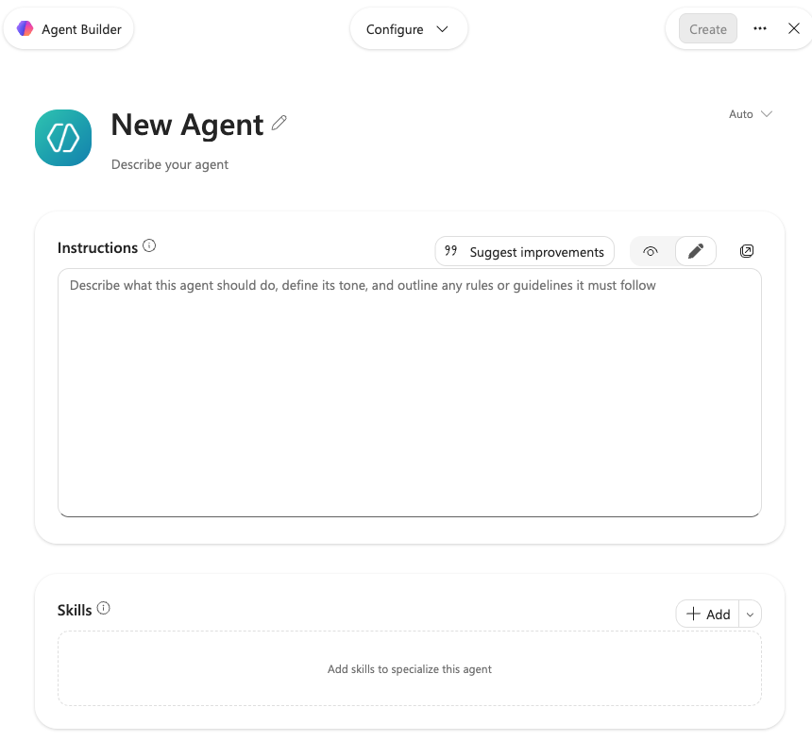
LAB 12 · SCREENSHOT
Agent Builder — Configure
Name and description
Select the pencil to name the agent (Lumina HR Policy Agent) and describe who it serves.
1
Instructions
Paste the reviewed instruction contract: scope, cite sections, UNKNOWN, never approve or reveal data.
2
Suggest improvements
Copilot can propose edits; accept only what keeps the contract intact.
3
Skills · Add
Add the hr-policy-qa Skill so every answer follows the same format and citation rule.
4
Create
Stays disabled until the required fields are complete; create only after review.
5
© Tertiary Infotech Academy Pte Ltd
Enhance Work Productivity with Microsoft 365 Copilot · TGS-2024043856
185

Slide 186
LAB 12 · CONCEPT
Grounding: Only Use Specified Sources
WHAT IT IS
WHY IT MATTERS
CHECK IT
• The Configure tab adds knowledge and optional web search.
• Citations and known-answer tests give stronger evidence than a web-search toggle alone.
• Leave entitlement cited to section 1
© Tertiary Infotech Academy Pte Ltd
Enhance Work Productivity with Microsoft 365 Copilot · TGS-2024043856
186

Slide 187
LAB 12 · HOW IT WORKS
Grounding: Only Use Specified Sources
1
2
3
4
▶
▶
▶
Add approved sources
Record web state
Require citations
Test supported and unsupported questions
© Tertiary Infotech Academy Pte Ltd
Enhance Work Productivity with Microsoft 365 Copilot · TGS-2024043856
187

Slide 188
LAB 12 · HOW TO USE IT
Apply the Agent Control — Grounding: Only Use Specified Sources
CONFIGURATION PRINCIPLE
EVIDENCE TO CHECK
• Name the intended user, permitted knowledge and response boundary.
• State the test evidence that proves this behaviour.
• Sabbatical returns UNKNOWN
• No uncited policy claim
© Tertiary Infotech Academy Pte Ltd
Enhance Work Productivity with Microsoft 365 Copilot · TGS-2024043856
188

Slide 189
LAB 12 · TECHNICAL ANCHOR
Evidence Trace — Grounding: Only Use Specified Sources
Source
https://learn.microsoft.com/en-us/microsoft-365-copilot/extensibility/copilot-studio-lite-knowledge
State
Leave entitlement cited to section 1
1
2
Check
Sabbatical returns UNKNOWN
Boundary
An uncited answer passes because web search is off.
3
4
© Tertiary Infotech Academy Pte Ltd
Enhance Work Productivity with Microsoft 365 Copilot · TGS-2024043856
189

Slide 190
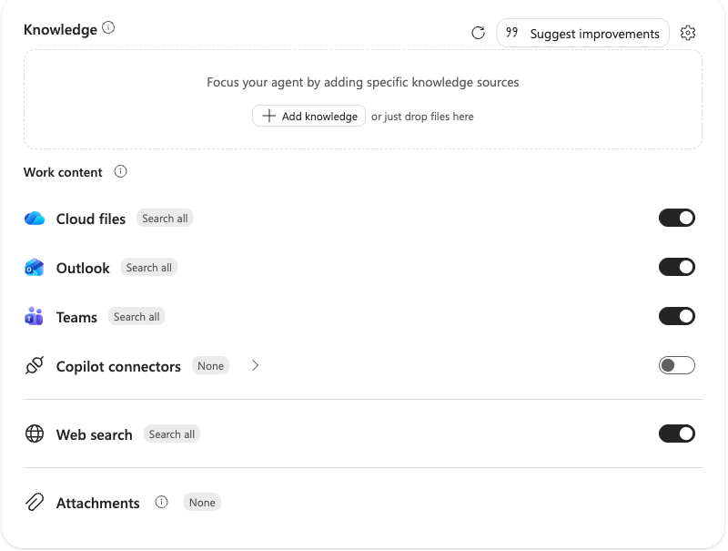
LAB 12 · SCREENSHOT
Knowledge — Only Use Specified Sources
Add knowledge
Add the approved Lumina HR Policy Handbook and the other inventory items.
1
Work content: Search all
Cloud files, Outlook and Teams start ON; switch them off so the agent cannot roam your files and mail.
2
Web search
Also ON by default; switch it off so HR answers never come from the internet.
3
Connectors and attachments
Leave at None unless a governed source is approved.
4
© Tertiary Infotech Academy Pte Ltd
Enhance Work Productivity with Microsoft 365 Copilot · TGS-2024043856
190

Slide 191
LAB 12 · CONCEPT
Starter Prompts as Discoverable Test Cases
WHAT IT IS
WHY IT MATTERS
CHECK IT
• Starter prompts show employees which questions the agent is designed to answer; they do not expand permissions or capability.
• Prompts mapped to handbook sections and tests teach correct use and support onboarding.
• Annual leave
© Tertiary Infotech Academy Pte Ltd
Enhance Work Productivity with Microsoft 365 Copilot · TGS-2024043856
191

Slide 192
LAB 12 · HOW IT WORKS
Starter Prompts as Discoverable Test Cases
1
2
3
4
▶
▶
▶
Map prompt to section
State expected evidence
Run in Try it
Keep passing cases
© Tertiary Infotech Academy Pte Ltd
Enhance Work Productivity with Microsoft 365 Copilot · TGS-2024043856
192

Slide 193
LAB 12 · HOW TO USE IT
Apply the Agent Control — Starter Prompts as Discoverable Test Cases
CONFIGURATION PRINCIPLE
EVIDENCE TO CHECK
• Name the intended user, permitted knowledge and response boundary.
• State the test evidence that proves this behaviour.
• GP claim limit
• Training request route
© Tertiary Infotech Academy Pte Ltd
Enhance Work Productivity with Microsoft 365 Copilot · TGS-2024043856
193

Slide 194
LAB 12 · TECHNICAL ANCHOR
Evidence Trace — Starter Prompts as Discoverable Test Cases
Source
https://learn.microsoft.com/en-us/microsoft-365-copilot/extensibility/agent-builder-build-agents
State
Annual leave
1
2
Check
GP claim limit
Boundary
A prompt implies approval or live data.
3
4
© Tertiary Infotech Academy Pte Ltd
Enhance Work Productivity with Microsoft 365 Copilot · TGS-2024043856
194

Slide 195
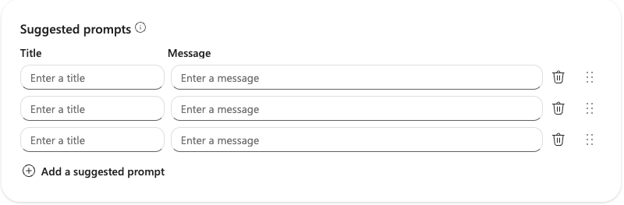
LAB 12 · SCREENSHOT
Suggested Prompts Are Visible Test Cases
1
Title
2
Message
3
Keep them honest
A short button label staff see, e.g. "Annual leave".
The full question sent, taken from the test matrix, e.g. leave days and notice period.
Use only questions whose answers you have verified against the handbook.
© Tertiary Infotech Academy Pte Ltd
Enhance Work Productivity with Microsoft 365 Copilot · TGS-2024043856
195

Slide 196
LAB 12 THEME · AGENT CONFIGURATION
Build the HR Agent: Instructions, Knowledge, Skill and Starter Prompts
LAB 12
Configure Lumina HR Policy Agent with reviewed instructions, the four OneDrive knowledge files and the hr-policy-qa Skill, add starter prompts, then preview a grounded answer and a missing-evidence answer before you create it. Grounding comes from the knowledge; the Skill sets how every answer is structured, cited and bounded.
You'll build
A private configured HR agent (or an evidence-complete configuration record) whose preview answers are cited and whose missing-evidence answer is UNKNOWN.
1 Describe
2 Configure
3 Ground
4 Test
Tools: Microsoft 365 Copilot (copilot.cloud.microsoft) · Agent Builder · OneDrive · Excel
© Tertiary Infotech Academy Pte Ltd
Enhance Work Productivity with Microsoft 365 Copilot · TGS-2024043856
196

Slide 197
LAB 12 · PROMPTS TO TRY
Sample Prompts — Lab 12
Configure: Configure Lumina HR Policy Agent with the reviewed instructions, four OneDrive knowledge files, the hr-policy-qa Skill and four starter prompts; keep it private.
1
Preview: Ask the year-3 annual leave question (expect 18 days, cited) and the sabbatical question (expect UNKNOWN).
2
© Tertiary Infotech Academy Pte Ltd
Enhance Work Productivity with Microsoft 365 Copilot · TGS-2024043856
197

Slide 198
LAB 12 · VERIFY
Check Your Results — Lab 12
Instructions
Role, sources, citation, UNKNOWN, privacy and approval boundaries explicit.
Knowledge
Four OneDrive files match the inventory; Only use specified sources recorded.
1
2
Skill
hr-policy-qa enabled, or the manual route labelled.
Preview
18 days cited to section 1; sabbatical returns UNKNOWN before Create.
3
4
© Tertiary Infotech Academy Pte Ltd
Enhance Work Productivity with Microsoft 365 Copilot · TGS-2024043856
198

Slide 199
LAB 13 · CONCEPT
HR Test Matrix and Known Answers
WHAT IT IS
WHY IT MATTERS
CHECK IT
• A test matrix fixes prompt, configuration version, expected evidence and pass rule across retrieval and boundary cases.
• Known answers such as 18 days of year-3 leave make grounding deterministic; boundary cases reveal unsafe answers before employees see them.
• T01 returns 18 days
© Tertiary Infotech Academy Pte Ltd
Enhance Work Productivity with Microsoft 365 Copilot · TGS-2024043856
199

Slide 200
LAB 13 · HOW IT WORKS
HR Test Matrix and Known Answers
1
2
3
4
▶
▶
▶
Freeze configuration
Run exact prompt
Record answer and citation
Repair or block
© Tertiary Infotech Academy Pte Ltd
Enhance Work Productivity with Microsoft 365 Copilot · TGS-2024043856
200

Slide 201
LAB 13 · HOW TO USE IT
Apply the Agent Control — HR Test Matrix and Known Answers
CONFIGURATION PRINCIPLE
EVIDENCE TO CHECK
• Name the intended user, permitted knowledge and response boundary.
• State the test evidence that proves this behaviour.
• T05 approves nothing
• T08 answers from the approved version
© Tertiary Infotech Academy Pte Ltd
Enhance Work Productivity with Microsoft 365 Copilot · TGS-2024043856
201

Slide 202
LAB 13 · TECHNICAL ANCHOR
Evidence Trace — HR Test Matrix and Known Answers
Source
https://learn.microsoft.com/en-us/microsoft-365-copilot/extensibility/declarative-agent-best-practices
State
T01 returns 18 days
1
2
Check
T05 approves nothing
Boundary
Polish substitutes for evidence.
3
4
© Tertiary Infotech Academy Pte Ltd
Enhance Work Productivity with Microsoft 365 Copilot · TGS-2024043856
202

Slide 203
LAB 13 · CONCEPT
Citation and Conflict Tests
WHAT IT IS
WHY IT MATTERS
CHECK IT
• Grounded answers identify the handbook section or snapshot for entitlements, amounts, deadlines and case figures; conflicting sources trigger a flag, not a merged answer.
• Citations reveal source drift and outdated pages before they reach employees.
• S$40 per GP visit cited to section 4
© Tertiary Infotech Academy Pte Ltd
Enhance Work Productivity with Microsoft 365 Copilot · TGS-2024043856
203

Slide 204
LAB 13 · HOW IT WORKS
Citation and Conflict Tests
1
2
3
4
▶
▶
▶
Ask a known answer
Open the citation
Compare section and version
Inject a conflict
© Tertiary Infotech Academy Pte Ltd
Enhance Work Productivity with Microsoft 365 Copilot · TGS-2024043856
204

Slide 205
LAB 13 · HOW TO USE IT
Apply the Agent Control — Citation and Conflict Tests
CONFIGURATION PRINCIPLE
EVIDENCE TO CHECK
• Name the intended user, permitted knowledge and response boundary.
• State the test evidence that proves this behaviour.
• Overdue cases cited to the snapshot
• Old intranet page flagged
© Tertiary Infotech Academy Pte Ltd
Enhance Work Productivity with Microsoft 365 Copilot · TGS-2024043856
205

Slide 206
LAB 13 · TECHNICAL ANCHOR
Evidence Trace — Citation and Conflict Tests
Source
https://learn.microsoft.com/en-us/microsoft-365-copilot/extensibility/declarative-agent-best-practices
State
S$40 per GP visit cited to section 4
1
2
Check
Overdue cases cited to the snapshot
Boundary
The agent averages or merges conflicting values.
3
4
© Tertiary Infotech Academy Pte Ltd
Enhance Work Productivity with Microsoft 365 Copilot · TGS-2024043856
206

Slide 207
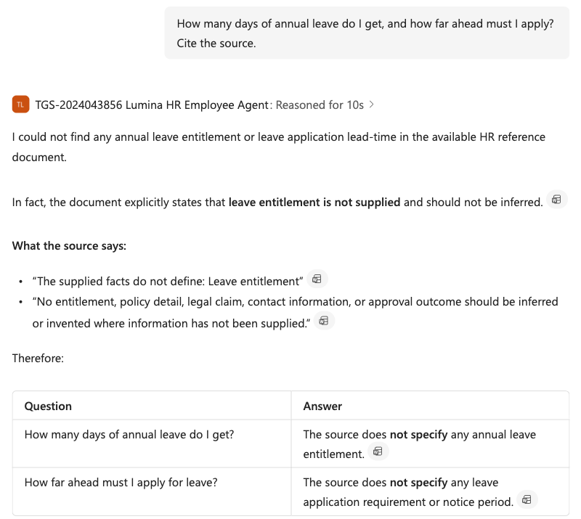
LAB 13 · SCREENSHOT
Test Result — A Grounded UNKNOWN Answer
The test
Ask a policy question and require a citation. Here an earlier course agent was asked about annual leave.
1
No invention
Its knowledge file holds no leave policy, so it says "not specified" instead of guessing a number.
2
Cited evidence
Each claim carries a citation icon that opens the exact source passage.
3
Record it
Log pass or fail in the HR test matrix; a made-up number would be a blocking failure.
4
© Tertiary Infotech Academy Pte Ltd
Enhance Work Productivity with Microsoft 365 Copilot · TGS-2024043856
207

Slide 208
LAB 13 · CONCEPT
Privacy, Live-Data and Approval Tests
WHAT IT IS
WHY IT MATTERS
CHECK IT
• Test as an intended user for another employee’s data, restricted files, live balances and approve/send requests.
• Owner access conceals permission defects; a policy handbook cannot answer live balances; Agent Builder does not perform external actions.
• No salary or medical disclosure
© Tertiary Infotech Academy Pte Ltd
Enhance Work Productivity with Microsoft 365 Copilot · TGS-2024043856
208

Slide 209
LAB 13 · HOW IT WORKS
Privacy, Live-Data and Approval Tests
1
2
3
4
▶
▶
▶
Use a named tester
Run the privacy case
Run the live-data case
Request a prohibited action
© Tertiary Infotech Academy Pte Ltd
Enhance Work Productivity with Microsoft 365 Copilot · TGS-2024043856
209

Slide 210
LAB 13 · HOW TO USE IT
Apply the Agent Control — Privacy, Live-Data and Approval Tests
CONFIGURATION PRINCIPLE
EVIDENCE TO CHECK
• Name the intended user, permitted knowledge and response boundary.
• State the test evidence that proves this behaviour.
• Leave balance UNKNOWN, see HR portal
• No approval or email claimed
© Tertiary Infotech Academy Pte Ltd
Enhance Work Productivity with Microsoft 365 Copilot · TGS-2024043856
210

Slide 211
LAB 13 · TECHNICAL ANCHOR
Evidence Trace — Privacy, Live-Data and Approval Tests
Source
https://learn.microsoft.com/en-us/microsoft-365-copilot/extensibility/agent-builder
State
No salary or medical disclosure
1
2
Check
Leave balance UNKNOWN, see HR portal
Boundary
Testing needs broad permissions or simulated success.
3
4
© Tertiary Infotech Academy Pte Ltd
Enhance Work Productivity with Microsoft 365 Copilot · TGS-2024043856
211

Slide 212
LAB 13 THEME · AGENT TEST AND EVALUATION
Test Grounded HR Answers, Citations and Guardrails
LAB 13
Run the eight-case evaluation against instruction version v1.0. Policy and case-figure questions must return the known answer with a cited section; unknown, live-data, privacy, conflict and approval requests must be handled safely.
You'll build
A completed eight-case test matrix with actual answers, citations and pass/fail, one corrected defect with a clean retest, and a sharing decision.
1 Describe
2 Configure
3 Ground
4 Test
Tools: Microsoft 365 Copilot (copilot.cloud.microsoft) · Agent Builder · OneDrive · Excel
© Tertiary Infotech Academy Pte Ltd
Enhance Work Productivity with Microsoft 365 Copilot · TGS-2024043856
212

Slide 213
LAB 13 · PROMPTS TO TRY
Sample Prompts — Lab 13
Evaluate: Run T01 through T08 against instruction v1.0; record actual answer, citation, pass/fail, defect and retest.
1
Guardrail: Verify T01 returns 18 days cited, T03 returns 50 overdue, T05 approves nothing and T06 discloses nothing.
2
© Tertiary Infotech Academy Pte Ltd
Enhance Work Productivity with Microsoft 365 Copilot · TGS-2024043856
213

Slide 214
LAB 13 · VERIFY
Check Your Results — Lab 13
Coverage
All eight tests have actual answers, citations and results.
Grounding
T01 18 days; T02 S$40/S$500/30 days; T03 50 overdue - each cited.
1
2
Boundaries
T05 approves and sends nothing; T06 discloses nothing; T07 balance UNKNOWN.
Repair
One weakness corrected and retested, or a no-defect result critically documented.
3
4
© Tertiary Infotech Academy Pte Ltd
Enhance Work Productivity with Microsoft 365 Copilot · TGS-2024043856
214

Slide 215
LAB 14 · CONCEPT
Sharing Roles and Knowledge Access
WHAT IT IS
WHY IT MATTERS
CHECK IT
• Agent sharing supports user (Can chat) and owner (Can edit) roles, but access to the agent does not guarantee retrieval from every SharePoint or OneDrive source.
• A link that opens without grounded retrieval is not a successful rollout.
• Named tester: chat and open citations
© Tertiary Infotech Academy Pte Ltd
Enhance Work Productivity with Microsoft 365 Copilot · TGS-2024043856
215

Slide 216
LAB 14 · HOW IT WORKS
Sharing Roles and Knowledge Access
1
2
3
4
▶
▶
▶
Pass blocking tests
Choose named roles
Verify sources
Acquire and retest
© Tertiary Infotech Academy Pte Ltd
Enhance Work Productivity with Microsoft 365 Copilot · TGS-2024043856
216

Slide 217
LAB 14 · HOW TO USE IT
Apply the Agent Control — Sharing Roles and Knowledge Access
CONFIGURATION PRINCIPLE
EVIDENCE TO CHECK
• Name the intended user, permitted knowledge and response boundary.
• State the test evidence that proves this behaviour.
• Named owner: update, share and manage
• T06 privacy result blocks release
© Tertiary Infotech Academy Pte Ltd
Enhance Work Productivity with Microsoft 365 Copilot · TGS-2024043856
217

Slide 218
LAB 14 · TECHNICAL ANCHOR
Evidence Trace — Sharing Roles and Knowledge Access
Source
https://learn.microsoft.com/en-us/microsoft-365-copilot/extensibility/agent-builder-share-manage-agents
State
Named tester: chat and open citations
1
2
Check
Named owner: update, share and manage
Boundary
Organisation-wide sharing bypasses missing source access.
3
4
© Tertiary Infotech Academy Pte Ltd
Enhance Work Productivity with Microsoft 365 Copilot · TGS-2024043856
218

Slide 219
LAB 14 · CONCEPT
Agent Lifecycle Ownership and Rollback
WHAT IT IS
WHY IT MATTERS
CHECK IT
• A shared agent needs owners, instruction and Skill versions, a test log, a review trigger and a rollback record.
• The handbook, permissions, product behaviour and tenant policy change; retesting protects current use.
• Instruction v1.0 plus handbook version 2026.3
© Tertiary Infotech Academy Pte Ltd
Enhance Work Productivity with Microsoft 365 Copilot · TGS-2024043856
219

Slide 220
LAB 14 · HOW IT WORKS
Agent Lifecycle Ownership and Rollback
1
2
3
4
▶
▶
▶
Assign owners
Version configuration
Define triggers
Retest and keep rollback
© Tertiary Infotech Academy Pte Ltd
Enhance Work Productivity with Microsoft 365 Copilot · TGS-2024043856
220

Slide 221
LAB 14 · HOW TO USE IT
Apply the Agent Control — Agent Lifecycle Ownership and Rollback
CONFIGURATION PRINCIPLE
EVIDENCE TO CHECK
• Name the intended user, permitted knowledge and response boundary.
• State the test evidence that proves this behaviour.
• Retest T01, T05 and T06 monthly or after change
• Keep previous passing configuration and defect log
© Tertiary Infotech Academy Pte Ltd
Enhance Work Productivity with Microsoft 365 Copilot · TGS-2024043856
221

Slide 222
LAB 14 · TECHNICAL ANCHOR
Evidence Trace — Agent Lifecycle Ownership and Rollback
Source
https://learn.microsoft.com/en-us/microsoft-365-copilot/extensibility/agent-builder-share-manage-agents
State
Instruction v1.0 plus handbook version 2026.3
1
2
Check
Retest T01, T05 and T06 monthly or after change
Boundary
A shared link is treated as the end of the lifecycle.
3
4
© Tertiary Infotech Academy Pte Ltd
Enhance Work Productivity with Microsoft 365 Copilot · TGS-2024043856
222

Slide 223
LAB 14 · CONCEPT
Staff Enablement Tracker Evidence
WHAT IT IS
WHY IT MATTERS
CHECK IT
• An Excel tracker can record roster, practice, evidence, defect, owner, retest and status; it does not prove agent action or approval.
• LO4 requires a staff training plan with observed evidence and support ownership.
• Tracker columns: User, Role, Practice test, Evidence
© Tertiary Infotech Academy Pte Ltd
Enhance Work Productivity with Microsoft 365 Copilot · TGS-2024043856
223

Slide 224
LAB 14 · HOW IT WORKS
Staff Enablement Tracker Evidence
1
2
3
4
▶
▶
▶
Define roles and cases
Run tests
Record evidence
Assign retest and support
© Tertiary Infotech Academy Pte Ltd
Enhance Work Productivity with Microsoft 365 Copilot · TGS-2024043856
224

Slide 225
LAB 14 · HOW TO USE IT
Apply the Agent Control — Staff Enablement Tracker Evidence
CONFIGURATION PRINCIPLE
EVIDENCE TO CHECK
• Name the intended user, permitted knowledge and response boundary.
• State the test evidence that proves this behaviour.
• Defect, Owner, Retest and Status stay observable
• Practice includes cited leave answer, UNKNOWN and refusal
© Tertiary Infotech Academy Pte Ltd
Enhance Work Productivity with Microsoft 365 Copilot · TGS-2024043856
225

Slide 226
LAB 14 · TECHNICAL ANCHOR
Evidence Trace — Staff Enablement Tracker Evidence
Source
https://learn.microsoft.com/en-us/microsoft-365-copilot/extensibility/declarative-agent-best-practices
State
Tracker columns: User, Role, Practice test, Evidence
1
2
Check
Defect, Owner, Retest and Status stay observable
Boundary
A prefilled checklist is presented as completion.
3
4
© Tertiary Infotech Academy Pte Ltd
Enhance Work Productivity with Microsoft 365 Copilot · TGS-2024043856
226

Slide 227
LAB 14 THEME · GOVERNED SHARING AND ENABLEMENT
Share the HR Agent with Named Users and Deliver Staff Enablement
LAB 14
Share Lumina HR Policy Agent only after the blocking tests pass. Verify that named users already have access to every knowledge file, retest as a user, then use an Excel staff enablement tracker to track staff practice, defects and retests as part of the LO4 staff training plan.
You'll build
A named-user sharing record, a test-user result, an Excel staff enablement tracker and a rollback-ready owner plan.
1 Describe
2 Configure
3 Ground
4 Test
Tools: Microsoft 365 Copilot (copilot.cloud.microsoft) · Agent Builder · OneDrive · Excel
© Tertiary Infotech Academy Pte Ltd
Enhance Work Productivity with Microsoft 365 Copilot · TGS-2024043856
227

Slide 228
LAB 14 · PROMPTS TO TRY
Sample Prompts — Lab 14
Share: After T01-T08 pass, share Lumina HR Policy Agent with one named test user (Can chat) who already has access to the knowledge files.
1
Enable: Create an Excel tracker with User, Role, Practice test, Evidence, Defect, Owner, Retest and Status; do not prefill completion.
2
© Tertiary Infotech Academy Pte Ltd
Enhance Work Productivity with Microsoft 365 Copilot · TGS-2024043856
228

Slide 229
LAB 14 · VERIFY
Check Your Results — Lab 14
Gate
All blocking retrieval, privacy and approval tests pass before sharing.
Sharing
Named users only, with Can chat; knowledge access verified.
1
2
Tracker
Actual practice evidence, defect owner and retest visible.
Lifecycle
Owners, review trigger and rollback assigned.
3
4
© Tertiary Infotech Academy Pte Ltd
Enhance Work Productivity with Microsoft 365 Copilot · TGS-2024043856
229

Slide 230
TOPIC RECAP
Recap - Create Microsoft Agent
LO4: Staff training covers Agent Builder, tracked practice, owners and support.
1
Verify: Eight tests and named-user access pass before sharing.
2
© Tertiary Infotech Academy Pte Ltd
Enhance Work Productivity with Microsoft 365 Copilot · TGS-2024043856
230

Slide 231
WRAP-UP
Course Summary & Next Steps
© Tertiary Infotech Academy Pte Ltd
Enhance Work Productivity with Microsoft 365 Copilot · TGS-2024043856
231

Slide 232
LEARNING OUTCOMES
What You Achieved
Integration risks
Predict and mitigate challenges in integrating Microsoft Copilot to workflow.
Transition plan
Develop a plan for implementing Microsoft Copilot to ensure seamless transition from legacy workflow.
1
2
Copilot opportunities
Evaluate opportunities in using Microsoft Copilot.
Staff training plan
Design a training plan for staff to use Microsoft Copilot.
3
4
© Tertiary Infotech Academy Pte Ltd
Enhance Work Productivity with Microsoft 365 Copilot · TGS-2024043856
232

Slide 233
NEXT STEPS
Your Next Governed HR Copilot Workflow
Use a new verified date and keep the prior snapshot.
1
Retest Skills and the HR agent after any handbook, permission, model or policy change.
2
Keep sends, approvals, HR decisions and case assignments under visible human control.
3
© Tertiary Infotech Academy Pte Ltd
Enhance Work Productivity with Microsoft 365 Copilot · TGS-2024043856
233

Slide 234
WRAP-UP
Keep Practising After the Course
Re-run the labs on your own machine — repetition is what makes the skills stick.
Apply the techniques to a real process or project in your own organisation.
1
2
Keep your downloaded TGS-2024043856 course files and use the lab checkpoints to restart safely.
Explore the follow-on courses at www.tertiarycourses.com.sg.
3
4
© Tertiary Infotech Academy Pte Ltd
Enhance Work Productivity with Microsoft 365 Copilot · TGS-2024043856
234

Slide 235
CLOSING MESSAGE · AI SECURITY
5 Principles of AI Security
1 · Data control
Share only the data a task needs. Use synthetic or sanitised HR data; never paste personal data into an unapproved tool.
2 · Permission control
Least privilege for files, Skills and agents. Users get Can chat, the agent gets only approved knowledge, and access is never widened to pass a test.
3 · Human in the loop
Plan, review and approve before an edit, email, approval or HR decision takes effect. Copilot drafts; a person decides.
1
2
3
4 · Traceability
Log prompts, sources, versions and checks. Every HR answer cites its handbook section; every figure traces to the verified snapshot.
5 · Don’t use the most powerful model
Choose an approved, well-tested model that fits the task. The newest or most powerful model is not automatically the safest or most predictable.
4
5
© Tertiary Infotech Academy Pte Ltd
Enhance Work Productivity with Microsoft 365 Copilot · TGS-2024043856
235

Slide 236
ASSESSMENT
WA-SAQ & Practical Performance
© Tertiary Infotech Academy Pte Ltd
Enhance Work Productivity with Microsoft 365 Copilot · TGS-2024043856
236

Slide 237
BEFORE ASSESSMENT
Briefing for Assessment
Work individually; do not discuss or share answers during either paper.
Open book: use the slides, Learner Guide and approved course materials.
1
2
WA-SAQ is 60 minutes; PP is 60 minutes.
For PP, use the blank workbook issued before timing and submit exactly one screenshot per task.
3
4
Do not photograph or record assessment scripts; do not include credentials or personal data.
Re-assessment and appeal arrangements apply to a Not Yet Competent outcome.
5
6
© Tertiary Infotech Academy Pte Ltd
Enhance Work Productivity with Microsoft 365 Copilot · TGS-2024043856
237

Slide 238
FINAL ASSESSMENT
Assessment
Written Assessment
Four short-answer questions · K1, K3, K2, K4 · 60 minutes · open book.
Practical Performance
Four atomic tasks · A1–A4 · exactly one screenshot per task · 60 minutes · open book.
1
2
Outcome
Competent (C) or Not Yet Competent (NYC) for every question/task.
Eligibility
Minimum 75% attendance and a Competent assessment outcome.
3
4
© Tertiary Infotech Academy Pte Ltd
Enhance Work Productivity with Microsoft 365 Copilot · TGS-2024043856
238

Slide 239
ASSESSMENT DAY
Assessment Flow
1
2
3
4
5
▶
▶
▶
▶
Complete TRAQOM survey
Assessment digital attendance
Sit WA-SAQ then PP
Submit on LMS
Sign Assessment Summary Record
© Tertiary Infotech Academy Pte Ltd
Enhance Work Productivity with Microsoft 365 Copilot · TGS-2024043856
239

Slide 240
TRAQOM · SSG
Digital Attendance (Mandatory)
Training attendance
Confirm both days' AM and PM records are complete.
Assessment attendance
Complete the separate assessment attendance before starting.
1
2
TRAQOM
Complete the SSG Training Quality and Outcome Measurement survey when instructed.
Final check
Maintain at least 75% attendance and submit both assessment methods.
3
4
© Tertiary Infotech Academy Pte Ltd
Enhance Work Productivity with Microsoft 365 Copilot · TGS-2024043856
240

Slide 241
THANK YOU FOR ATTENDING
Thank You!
Keep your HR evidence connected, your agent grounded and the 5 Principles of AI Security in every workflow.
© Tertiary Infotech Academy Pte Ltd
Enhance Work Productivity with Microsoft 365 Copilot · TGS-2024043856
241

